Slide 1
Exempt Service Contracts: Labor, Immigration, and Classification Traps to Avoid
Jon Levin, David Block, Stephen Davis
Government Solutions Group

Slide 2
Introductions and Housekeeping
Maynard Cooper & Gale 2017 Webinar Series
This Month’s Subject: Exempt Service Contracts: Labor, Immigration, and Classification Traps to Avoid
Webinar is hosted by ReadyTalk. You can ask questions by typing into the box in the bottom corner of the screen. We will answer in real-time or shortly after the webinar.
We will send slides out this week to all registered attendees.
Notes:
Mike Heaton – Mike Heaton (Federal Systems and Services, LLC) offers 40 years of experience in the areas of Business Development, Capture Management, Proposal Support and Contract Execution/Administrative Support through independent consulting services to firms wanting to work for the Federal Government. This consulting business follows Mike selling an engineering firm previously recognized as the #1 U.S. Small Business Prime Contractor of the Year.
Leslie Leaver – Leslie is the owner and CEO of Strategic Business Solutions. SBS is a full-scope proposal center that helps clients and drafts all proposal volumes, including technical writing, costing, and responding to ENs during discussions. SBS also does quality systems implementations and grant writing.

Slide 3
Road Map
Common FLSA Pitfalls
Immigration Update
Is there “Double Trouble” in our future?

Slide 4
Fair Labor Standards Act Basics
Sets Minimum Wage and OT obligations
“Default” rule is that everyone should be hourly/non-exempt
Certain types of employees can be exempt from minimum wage and OT
Record-keeping requirements

Slide 5
Common FLSA Pitfalls
Misclassification of workers as exempt
Not paying for all time “worked”

Slide 6
What’s Up With New OT Regs?
RIP? So coast is clear, right?
Heightened awareness among workers
We expect to see increased “Misclassification” Cases
Potential issue for labor organizers

Slide 7
Fair Labor Standards Act Basics
Many defense contractors have trouble with exemption concept
Misplaced Focus On:
Job titles
Job descriptions
Contract descriptions
How you bill customer vs. how you pay employee
The way “it’s always been done”
Your accounting database

Slide 8
To Exempt or Non-Exempt
Salary Threshold
Still $455/wk* (unless local law requires more)
Paid on salary basis
Deductions come in to play here
Paid on Salary Basis
Duties Test
Each element must be met or default rule applies

Slide 9
To Exempt or Non-exempt
Executive
Salary Test
Primary duty:
Managing the business
Supervise two or more full time employees (or equivalent)
Notes:
This is a fluff slide feel free to remove it

Slide 10
To Exempt or Non-exempt
Administrative
Salary Test
Primary duty:
Office or non-manual work directly related to management or operations of the business
Exercises independent judgment or discretion
Over “matters of significance” to management or operations

Slide 11
Danger!
The DOL takes the position that if an employee works in a “production” position, s/he should be hourly
What is “production” in your operation?

Slide 12
More Danger!
Indirect: Contracts, Bookkeepers, Accounts Payable, Accounts Receivable;
Direct: Any supervisor/lead that is involved in the “production process” on a regular basis

Slide 13
To Exempt or Non-exempt
Professional
Salary Test
Work requiring “advance knowledge in a field of science/learning, obtained through a prolonged course of advanced, specialized intellectual instruction”
Consistent exercise of independent discretion/judgment
Notes:
This is a fluff slide feel free to remove it

Slide 14
To Exempt or Non-exempt
Computer Employee
Salary Threshold or $27.63/hour
Employed as analyst, programmer or engineer
Primary duty of design, development or systems analysis
Notes:
Question: How does the hourly rate come into play here? Is there any impact here, other than the salary threshold goes up? Does the hourly/27.63 remain?
Computer Employee Exemption To qualify for the computer employee exemption, the following tests must be met: • The employee must be compensated either on a salary or fee basis at a rate not less than $455 per week or, if compensated on an hourly basis, at a rate not less than $27.63 an hour;

Slide 15
Common Problems: Deductions
Example: Employer requires employees (exempt or not) to account for at least 40 hours a week in Cost point.
What if an exempt employee has doctor’s appointment from 10-12 on a work day, but otherwise works a full day?
Can you simply dock 2 hours?
Require her to use 2 hours of paid leave?
What if she has exhausted her paid leave?

Slide 16
Common Pitfalls with Non-Exempt Employees
Any time employee claims to be working whether “requested,” “suffered,” or “permitted” by the employer.
Requiring employees to account for 40 hours a week
The “8 hours per day/40 hours per week” timecard
Not capturing all work time
“Requiring” employees to work “off the clock”

Slide 17
Common Pitfalls with Non-Exempt Employees
“Comp Time” currently is not allowed
“Working Families Flexibility Act of 2017” (H.R. 1180) passed on May 2
Must pay an employee who worked overtime without prior approval
“On call” time
If an employee is required to remain on-call on employer’s premises, or so close that he cannot use the time effectively for his own purposes, it is considered compensable time

Slide 18
Common Pitfalls with Non-Exempt Employees
Do you have to pay your employee for attending lectures, meetings, training, etc.?
Default Rule is: YES
Exception only applies if each of the following conditions are met:
Attendance is outside of the employee’s regular hours;
Attendance is completely voluntary;
Attendance is not directly related to the employee’s job; and
Employee does not perform any productive work during the program

Slide 19
Immigration Update

Slide 20
Immigration Basics
Federal Immigration Law requires employers to:
Properly fill out I-9 forms on employees
Hire only authorized workers
Treat all workers equally, regardless of citizenship or national origin

Slide 21
What to Expect in the Trump Administration
Focus under the Trump Administration will be on enforcing existing immigration laws
Heightened I-9 enforcement and emphasis on employers who have employees on temporary work visas

Slide 22
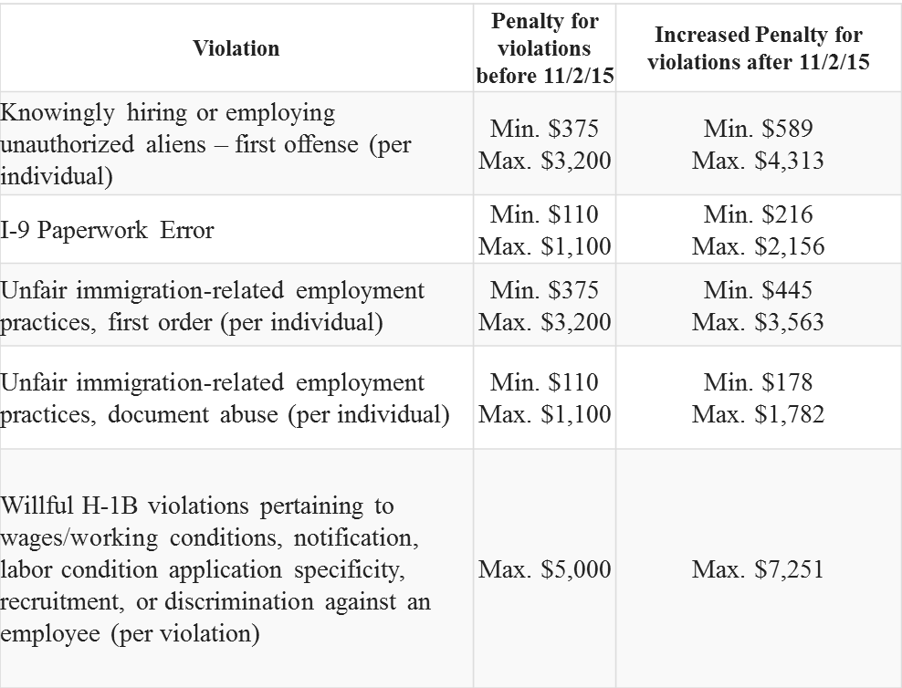
Increase in Immigration Fines
Effective August 1, 2016, DOJ increased fines

Slide 23
Increased I-9 Fines
The biggest increase is for I-9 violations
Fines for I-9 ‘paperwork errors’ have increased 96%
Immigrations and Customs Enforcement (ICE) is increasing audits and workplace raids

Slide 24
Increased ICE Audits
Under President Obama, ICE had 1,000 agents assigned to I-9 audits
President Trump wants to hire 20,000 new ICE agents (many for I-9 enforcement)

Slide 25
Increased ICE Audits
ICE Audits
Starts with Notice of Inspection (NOI) to the worksite
Often show up unannounced
Ask questions
Ask for documents
Employer has 3 days to make I-9 forms available

Slide 26
Preparing for I-9 Compliance
What can you do to protect yourself?
Train your employee on how to complete I-9 Forms
Develop consistent procedures
Review their work

Slide 27
Preparing for I-9 Compliance
Conduct internal I-9 audit
Connecting violations now can help in later ICE audit
It can demonstrate good faith and help lower fines
Establish onsite audit protocol
Have “Team”
Understand Process/rights

Slide 28
“Fraud in Visa Programs”
Increased H-1B Enforcement
Fraud Detection and National Security (FDNS) is a division of U.S. Citizenship and Immigration Services (USCIS)
FDNS investigates compliance with H-1B program
FDNS officers visit the workplace unannounced
Cooperation is voluntary (at first)

Slide 29
“Fraud” in Visa Programs
FDNS officers will want:
To talk with supervisors & employees about work conditions
Documentation about the employee’s work/pay
Pay stubs
Copy of job descriptions
Copy of visa approval notice
Employee’s passport

Slide 30
Supreme Court Allows Parts of Travel Ban to Take Affect
Foreign nationals from Libya, Iran, Somalia, Sudan, Syria and Yemen will be barred from entering the U.S. for 90 days, unless . . .
They can show a “bona fide” relationship with a person or entity in the U.S.
For example, being enrolled in a college or university or employed by a U.S. employer should be considered a bona fide relationship

Slide 31
Double Trouble (The Proposed Merger of EEOC and OFCCP)

Slide 32
Double Trouble
The Administration is proposing the merger of EEOC and OFCCP
The agencies are expected to coordinate the merger by end of fiscal year 2018

Slide 33
Double Trouble
The Agencies have different purposes, procedures and remedial measures:
EEOC focus is on preventing discrimination (e.g., reliance on individual complaints; enforcement with civil actions; enforce broader array of laws) vs.
OFCCP focus is on Affirmative Action (e.g., does not rely solely on complaints; focus is systemic and process discrimination)

Slide 34
Double Trouble
Experts fret over the difficulty of merging the two different ecosystems
Most think Congressional approval is required
In a DC that agrees on virtually nothing…. Just about everyone opposes

Slide 35
QUESTIONS?

