Slide 1


Subcontracts Administration: Working with DCAA and DCMA
Jon Levin
Maynard Cooper & Gale
Asa Gilliland
Redstone Government Consulting

Slide 2
Introductions and Housekeeping
Maynard Cooper & Gale 2017 Webinar Series.
This Month’s Subject: Subcontracts Administration - - Working with DCAA and DCMA.
Webinar is hosted by ReadyTalk. You can ask questions by typing into the box in the bottom corner of the screen. We will answer in real-time or shortly after the webinar.
We will send out slides this week to all registered attendees.
Guest speaker this week - - Asa Gilliland, Redstone Government Consulting
Notes:
Jon: Our guest speaker this week is Asa Gilliland from Redstone Government Consulting. I work with Asa often. He is truly an expert in government cost and price compliance and issues. When one of our clients has a complicated issue requiring direct interface with DCAA or DCMA, Asa is on my speed dial. Asa and his team also put together cost proposals and are a tremendous value-add in this regard.
Asa: Jon thanks again for inviting me today to talk about Subcontract Management. Jon always pulls me in for the most stirring topics. He and I have had the opportunity to work together for a number of years on several different matters and during that time we’ve gotten to be pretty good friends, so you guys can expect some bantering back and forth today with goal being to inform but also make this topic as entertaining as possible. In my job assisting government contractors with compliance and accounting issues I’m thankful to have Jon on speed dial for assistance on a variety of issues where our professions intersect. Whether it’s complex bid protest, REAs, Claims, Disputes or just to bounce ideas/interpretations off of Jon and the folks at Maynard have been extremely knowledgeable and helpful to me and many of our clients through the years.

Slide 3
Acronyms
CO/KO Contracting Officer (Procuring or Administrative)
DCAA Defense Contract Audit Agency
DCMA Defense Contract Management Agency
DoD Department of Defense
DoD-IG DoD - Inspector General
ASBCA/BCA Armed Services Board of Contract Appeals
FAR Federal Acquisition Regulations
DFARS Defense Federal Acquisition Regulations Supplement
CAM Contract Audit Manual (DCAA)
FCA False Claims Act
SAT Simplified Acquisition Threshold
Notes:
It seems that acronyms are like the hashtags of the government world. If one doesn’t exist you can just make up your own as you go along. They get built into the vernacular, and since we’re speaking to an open audience today with all levels of experience in attendance we’ll try to keep the acronym speak to a minimum, but there are some that we’ll use throughout the day. If we make any up feel free to ask in the question box and we’ll be happy to define.

Slide 4
Agenda
The Subcontract Environment in Government Contracting
Walkthrough of the Subcontract Life Cycle
  Pre-Award
  Post-Award
  Closeout
As we go through each of these phases we’ll intersect current events and provide some general recommendations for you

Slide 5
Before Award - - Limitations on Subcontracting
Putting Your Team Together - - Price and Cost Considerations
  Limitations on Subcontracting for small business prime contractors
  Focuses on “amount paid” by Government
  Applies to all contracts above the SAT
  Similarly situated entity rule included in “amount paid”
    Same small business program status as contractor
    Size based on subcontract, not prime contract
  Services: prime will not pay more than 50% of amount paid by Government to subcontractors (including similarly situated entities)
  Supplies: prime will not pay more than 50% of the amount paid by the Government to subcontractors (including similarly situated entities)
  Mixed supplies and services: limitations apply to primary purpose of contract; no limitation for other portion of contract
  Construction: prime will not pay more than 15% of the cost of the contract, not including cost of materials, paid by the Government to subcontractors (including similarly situated entities)
Notes:
Difficult to win protests regarding the subonctracting limitation. Generally, whether a small business offeror will be able to comply with a subcontracting limitation presents a question of responsibility for review by the SBA. See 13 C.F.R. sect. 125.6(f); Spectrum Sec. Servs., Inc., B–297320.2; B–297320.3, Dec. 29, 2005, 2005 CPD para. 227 at 6. Issue must be couched as a proposal failing to conform to a material term of the solicitation. TYBRIN Corp., B- 298364.6 et al., Mar. 13, 2007, 2007 CPD ¶51. If not obvious from face of the proposal, then an issue of responsibility that gets sent to the SBA.

Slide 6
Before Award - - Cost and Price Analysis
Evaluation Technique in Solicitation - - cost or price?
Subcontractors consider pricing to be proprietary and will generally not provide to prime
Cost and price evaluation are separate evaluation techniques
  FAR 15.400 - - cost and price negotiation policies
  FAR 15.402 - - obligation to procure goods at “fair and reasonable prices”
  15.403 - - obtaining “cost or pricing data”
  15.404-1 - - price and cost analysis techniques
    Reasonableness
    Realism
      Cost contracts
      Fixed price contracts
Commercial items - - is there really an exception to obtaining cost or pricing data?
Notes:
For Discussion
First lets talk about the distinction between cost and price analysis. They are two separate analysis techniques, but they are often referred to in the singular. Price analysis is pretty self-explanatory, essentially comparing the total price proposed to historical, market or other sources of comparison to determine reasonableness. Cost analysis is always more challenging because it requires analysis of each individual element of cost. In the case of a labor rate you would be analyzing the base direct labor, each indirect burden and any profit or fee, and this leads to the majority of the challenge for Prime contractors. Most subcontractor consider all of these elements proprietary and will not grant access.
As you can see price analysis is certainly an easier approach, but in situations where TINA is applicable cost analysis would be required. Since access to cost data may be limited Primes are increasingly reliant on the use of government audit sources for cost analysis. The government ultimately makes the call on the degree of cost analysis, but it is the prime’s role to notify the government when cost analysis cannot be conducted. Just like FAR 52.244-2 Consent to subcontract, the government’s acceptance of a proposal or award of the prime contract does not indicate acceptance of subcontractors or their prices included in the proposal, so we must protect ourselves by informing the government in situations where adequate cost or price analysis cannot be conducted.
The DoD-IG has increasingly targeted commercial item acquisitions with most of the large aerospace contractors sitting firmly in their crosshairs, however this increased scrutiny follows the trickle down effect that is typical with government audit activities. During the past 4-years we have seen more and more commercial item defense and assistance with development of first time cost data for acquisitions of historically commercial parts/services at all tiers of government contractors. The takeaway here is that if you are selling to the USG on a commercial basis you should have a fallback position or a very strong negotiating position. If you are a prime and you are accepting commercial items under contract it is critical that you are conducting a thorough commercial item determination, as well as obtaining sales data, historical pricing and other information to support the agreed to price.

Slide 7
The Subcontract Environment - -
A Hot Topic for DCAA
Recent DCAA Incurred Cost Audit Exceptions
  $8.6MM CQ (cost questioned) due to subcontract labor inadequate documentation
  $52.2MM CQ unsupported direct labor and subcontract cost which stemmed from the prime’s failure to audit subcontract costs
  $37.9MM CQ as a result of no price analysis or evaluation of competitive bids (failure to document other than lowest price)
  20% decrement applied to all subcontract costs for inadequate monitoring
GAO Reports concerned with “bait and switch”
DoD-IG Reports
  2015-139 Estimating Systems (procedures that ensure that subcontract prices are reasonable based on document review/analysis
  2016-001 Business Systems DCAA’s interpretation of this report implicates management of subcontractors as potential business system deficiency
Notes:
Both from DCAA’s annual report to congress and other sources of information from inside the agency we are increasingly seeing DCAA auditors going after subcontract costs as part of incurred cost audits, business system audits, voucher examinations and voucher audits. We work with around 500 contractors throughout the U.S. and for the most of 2016 and thus far into 2017 this has been the single most consistent issue we are getting questions about from our client base.
Jon I know from a legal perspective this seems to be a pretty hot topic area as well with a variety of cases in recent memory that comes to mind? Suggest Laguna Construction, Circle C Construction, KBR CoFC Case. Just looking for a series of cases brief summary to build to the importance of the environmental trend.
Along with frequent commentary on this topic from GAO and the DoD-IG we’re also seeing this topics extension outside of DCAA and DoD in general to other agencies with recent issues from within DOE, DHHS and many other federal agencies. DOE in particular issued a recent audit report pertaining to the Hanford Nuclear Site, as well as stipulating a DOE prime contract clause requiring subcontract audits.

Slide 8
Prime Management of SubKs
Pre-Award Functions
How do we agree on price with our subcontractors?
DCAA MRD 09-PSP-011 Performing Audits of Subcontract Forward Pricing Rates
    Prime must perform at least price analysis (FAR 15.403(b))
    Adequate subcontractor proposals (DFARS Proposal Checklist)
    Involvement of Government Officials (DFARS PGI 215.404-3)
  Price analysis is required, but what about cost analysis?
  Access to subcontractor records?
  If the government elects to not conduct cost or price analysis are you out of the woods?
Commercial items?
  The past few years have been rocky in the world of commercial items
    Increasing requests for “other than cost or pricing data”
    DoD-IG reports targeting commercial prices paid
    Some relief (potentially) from 2017 NDAA with DoDs efforts to entice non-traditional contractors
Notes:
For Discussion
First lets talk about the distinction between cost and price analysis. They are two separate analysis techniques, but they are often referred to in the singular. Price analysis is pretty self-explanatory, essentially comparing the total price proposed to historical, market or other sources of comparison to determine reasonableness. Cost analysis is always more challenging because it requires analysis of each individual element of cost. In the case of a labor rate you would be analyzing the base direct labor, each indirect burden and any profit or fee, and this leads to the majority of the challenge for Prime contractors. Most subcontractor consider all of these elements proprietary and will not grant access.
As you can see price analysis is certainly an easier approach, but in situations where TINA is applicable cost analysis would be required. Since access to cost data may be limited Primes are increasingly reliant on the use of government audit sources for cost analysis. The government ultimately makes the call on the degree of cost analysis, but it is the prime’s role to notify the government when cost analysis cannot be conducted. Just like FAR 52.244-2 Consent to subcontract, the government’s acceptance of a proposal or award of the prime contract does not indicate acceptance of subcontractors or their prices included in the proposal, so we must protect ourselves by informing the government in situations where adequate cost or price analysis cannot be conducted.
The DoD-IG has increasingly targeted commercial item acquisitions with most of the large aerospace contractors sitting firmly in their crosshairs, however this increased scrutiny follows the trickle down effect that is typical with government audit activities. During the past 4-years we have seen more and more commercial item defense and assistance with development of first time cost data for acquisitions of historically commercial parts/services at all tiers of government contractors. The takeaway here is that if you are selling to the USG on a commercial basis you should have a fallback position or a very strong negotiating position. If you are a prime and you are accepting commercial items under contract it is critical that you are conducting a thorough commercial item determination, as well as obtaining sales data, historical pricing and other information to support the agreed to price.

Slide 9
Prime Management of SubKs
Pre-Award Functions
So you won the prime contract, now what? Time to negotiate and award that subcontract.
  First rule of government contracting…read (and understand) your contract.
    Flow down clauses, Terms, Conditions, Representations & Certifications
    Your subcontracts must be a hybrid of your company expectations and those of your government customer
    Ultimate goal is to limit your risk exposure by drafting language to protect your Company
    Map to prior T&Cs shared during proposal phase
    Consider help/second opinion when needed
Your government customer is not a party to your subcontract
Subcontracts are primarily governed by commercial law
Notes:
There’s a few general strategies to drafting effective subcontracts and the one we see all too commonly is the “dump everything in there and the sub will figure out what applies.” This is not a great approach to subcontracts. Jon care to comment on this approach?
A second, and somewhat better approach is the building block approach, which means you have specific sets of flow downs geared to the overall contract type so you may have one for cost-type, another for commercial, T&M and so forth. This is a better approach because it does limit the amount of expected negotiation, because at least the terms are relatively specific. Jon any pitfalls here? Issue I see with this is the similar to the one-size fits all. All too often subcontract manager fails to consider unique, contract specific terms & conditions and fails to adequately protect their Company. Another issue I’ve seen is having contract-type sets, but failing to take into account specific contract issues related to quality, property insurance, payment terms, et al. areas.
Jon figure you could add some commentary on bullet two (e.g. Christian Doctrine)
Ditto on bullet three (e.g. UCC, state level)
Maybe even a slide or two to follow on topics related to the draft of subcontracts? Would make a good transition point as this is the end of the pre-award section?

Slide 10
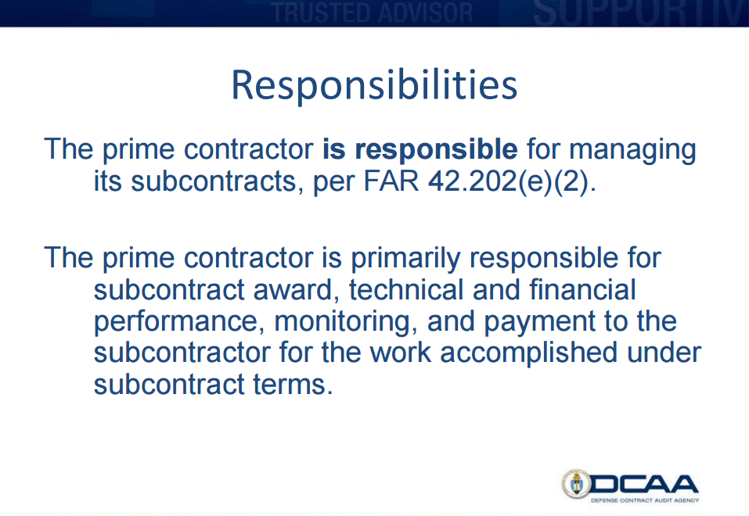
Prime Management of SubKs
Pre-Award Functions
Subcontract is negotiated and executed. We’re in the clear…right? Let’s check the FAR to be safe.
  FAR 42.202 Assignment of Contract Administration
  DFARS 242.7502 - - contractor required to maintain adequate accounting system
Wonder if DCAA offers any guidance in this area?
  http://www.dcaa.mil/small_business/Monitoring_Subcontracts.pdf
Notes:
FAR 42.202 states simply that the prime contractor is responsible for managing its subcontracts. Pretty straightforward right? No it’s about as clear as mud.
Thankfully though our friends at DCAA have determined the message behind such a vague term as manage. Then they developed a presentation geared specifically to new prime contractors to help them understand their role in this process. Presentation covers a lot of stirring topics like consent to subcontract and the allowable cost and payment clause, but focuses on the overarching them of subcontract management from FAR Part 32

Slide 11
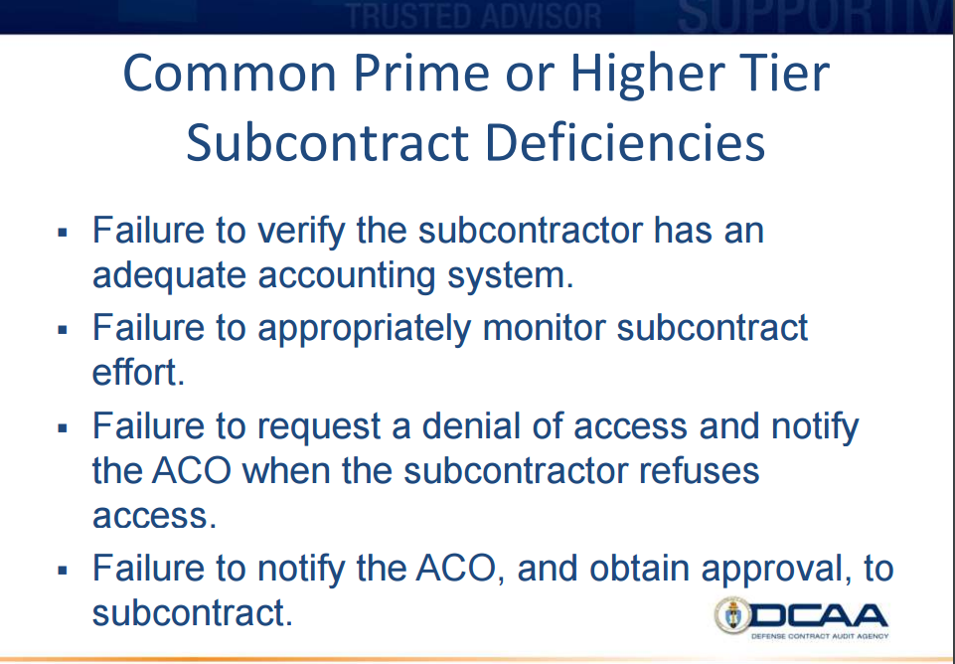
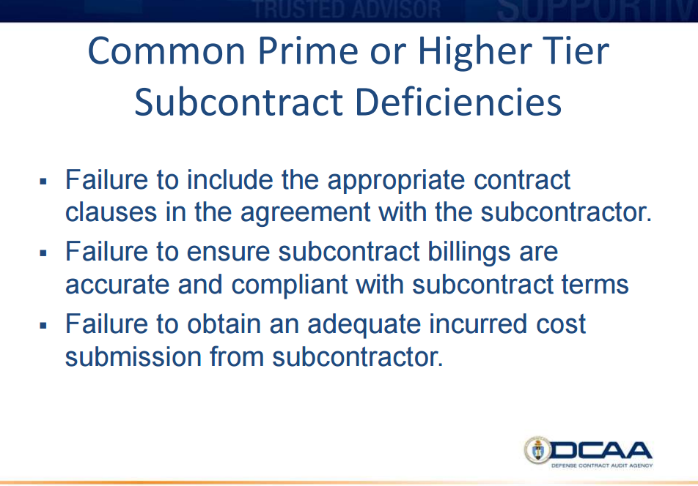
Prime Management of SubKs
Pre-Award Functions cont.
Wow, that’s a lot of stuff, and sounds suspiciously like things that DCAA typically does.
Notes:
If you’re not getting the message we’re stating that DCAA has been overreaching a bit in this area in recent history.

Slide 12
LMIS, ASBCA 59508-09 (December 20, 2016)
Alleged contractor breach of contract for failure to manage subcontract under the auspices of FAR 42.202(e)(2)
  DCAA’s Logic
    Prime had no proof of requests for audits
    No records indicating they attempted to cause the subcontractor to prepare an adequate indirect cost rate proposal
    Without an adequate indirect cost rate proposal the prime and DCAA are unable to audit subcontract costs claimed by the prime
    Subcontract management is the responsibility of the subcontract administration department (G&A) and the contractor had failed to earn reimbursement for those costs
    Ultimately questioned approximately $117MM in subcontract costs, which lead to the claims appeal to the ASBCA
Notes:
From review of the case this seems to be yet another example of a DCAA auditor latching onto a concept, but failing to connect that concept to the contractual agreement between the government and the prime contractor. In summary, the position presented by the government followed the logic of the auditor, and thankfully in this instance the court disagreed with that logic.
Asa to Jon: Jon it seems odd to me that DCAA could require proof of requests for audits? That’s quite the jump from the typical documentation described in the access to records clause.
Jon to Asa: I see this term adequate indirect rate proposal? What does DCAA mean by this?
Asa to Jon: Contractually, how could a prime compel the submission of an adequate indirect rate proposal? Would they even want to do that? [consider the fact that an ICS includes reporting on ALL contract activity, not a single contract]

Slide 13
LMIS, ASBCA 59508-09 (December 20, 2016)
The Board disagreed
  The rest of the story…
    The prime provided DCAA with extensive documentation (policies and procedures) ensuring oversight of subcontractors…to achieve delivery with documented acceptance of all services on all task orders,
    Prime advised the subcontractor of its responsibility to submit to DCAA all applicable schedules...prime ktr focus is on cost and performance of a single contract…not the overall incurred cost submission
    DCAA ignored relevant evidence, focused solely on the absence of subcontractor incurred cost claims...but without citing any FAR or contractual clause.
Notes:
I guess what is of most interest to me from this decision is how far it will extend into other issues. When you read what LMIS did to manage its subcontractors its very similar to the practices that we all see at most of the large prime contractors. The government seemed to lean heavily on the their implied requirements from FAR 42.202, and its connection to the allowable cost and payment clause which states that the prime is responsible for settling subcontractor amounts.
When you think about other areas of regulation where there is some intersection of prime/government post award duties what are some other potential challenges that we may see in the future of this area? things like TINA, CAS do you see any other instances where there may be reach for the government?

Slide 14
LMIS, ASBCA 59508-09 (December 20, 2016)
Some Key Takeaways from this case
  FAR 42.202(e)(2) is not a contractual clause
  Even if FAR 42.202(e)(2) was (a contractual clause), by their (its) plain terms they do not impose the duties that DCAA, CO and the Government alleged were breached,
  We (ASBCA) are presented a case based on a legal theory, originated by an auditor
  The contractor breach of these non-existent duties is the only basis for disallowing $103 Million.
  CASE DISMISSED
Notes:
Asa to Jon: So it seems to me that the Board has outlined a framework of what is acceptable for subcontract management during performance at least narrowly for time-and-material contract types? Shoot this down. Relying on case law is extremely problematic in practice unless the facts/circumstances align…does provide some good takeaways though.
Jon to Asa: It’s interesting to me that the government attorneys followed the auditors logic as the Board noted. What’s DCAA’s typical response when these types of decisions are made by the Board?

Slide 15
Parting thoughts
“If you know the enemy and know yourself, you need not fear the result of a hundred battles.” ~Sun Tzu
DCAA Most Common Subcontract Management Issues
  DCAA Indirect Cost Rates Audit Program (10100), Section F-1, Steps 2 and.4
  DCAA Testing of Paid Vouchers (11015), Section C-1, step 8 a –e
  DCAA Consultant & Professional Services Cost (10160) Section C-1
  DCAA MAAR-13 (10320), Section C-1, Step 7
  DCAA Eval. Of Final Voucher (15400) Section B-1, Step 4 & 7, C-1, Step 1 b. & 8
Notes:
Jon probably won’t appreciate me saying this, but my pocketbook would certainly fear the result of a hundred (legal) battles. The axiom remains true though. The single most important thing you can do as a prime contractor is understand the tactics and practices of the DCAA and other audit agencies and thankfully most of their approaches are publicly available information. From past experience dealing with executive compensation and other areas where the Board has completely disagreed with DCAA approaches it is not likely that we will see a change in approach from DCAA. Waving the LMIS case at them will not make them go away on these or other subcontract management issues, so it’s important to understand where you will face resistance determine where your company line is for managing subcontracts now and in the future.
The most common intersections we see with contractors and DCAA on the topic of subcontract management stems from the audit program areas noted. Probably the most common are Paid Voucher testing followed by indirect cost rates audit or the ICS.

Slide 16
Parting thoughts
Focus on billing policies and procedures providing reasonable assurance of satisfactory subcontract performance.
Prime defines managing subcontracts in the context of review and approval of subcontractor invoices, but not in the context of after-the-fact audits.
Do not inject “audits” into policies or procedures unless contractually required
Subcontractor self-certifications (accounting system, provisional rates, indirect cost rate proposal submission if explicitly required by prime contracts); but…self-certifications without any corroborating data are risky business
Consider subcontract clause with access to specified records and/or third party verification (reasonable assurance, but not an audit)
Notes:
So if we’re talking about a time and material contract we would want to have procedures to obtain evidence work was performed, and hours incurred….timesheets. We also need some mechanism of oversight of performance to provide that value-add required to dodge excessive pass through issues.
If your subcontractor is not cooperating make sure your ACO is in the loop and retain those communications
The word audit seems to mean something different to someone with an accounting background and someone with a contracts background. DCMA uses the word interchangeably with risk assessments and other non-attestation engagements. Do not use the word audit in your procedures unless you intend to seek an opinion under applicable attestation standards.
Jon to Asa: What are the applicable attestation standards?
Subcontractor self-certifications are fraught with problems, because almost anyone can call up someone like me for assistance in filling those out. As a prime I would really want some additional assurance beyond their ability to fill out a questionnaire. Not saying you have to ask for an audit, but we do work for several primes where we do a cursory interview to go over the questionnaire and gauge the subcontractors ability to discuss beyond the questionnaire as a means of additional risk assessment.
This brings me to the last point, which is you really want to have some means to access records necessary for contract closeout and should always think worst case. If they won’t grant access to the prime perhaps they will to an independent third party reviewer.

