Slide 1
Revised GLBA Safeguards Rule
MAACS
February 24, 2022
Brandon Sherman and Adam Griffin

Slide 2
Presenters
Brandon Sherman - Maynard Cooper & Gale
Adam Griffin - Maynard Cooper & Gale
Notes:
[Brandon]

Slide 3
Presenter Background
Brandon Sherman
Practice and Experience
  Previous Experience: Senior Counsel to the Deputy Secretary
  Advises institutions on meeting U.S. Department of Education cybersecurity requirements
  Counsels clients on the rules and procedures related to federal financial aid, accreditation, Title IX, and transactional issues
Contact Information
  Bsherman@MaynardCooper.com
  202-868-5925
Notes:
[Brandon]

Slide 4
Presenter Background
Adam Griffin
Practice and Experience
  Cybersecurity and compliance
  Work as breach coach to counsel organizations through incidents
Contact Information
  AGriffin@maynardcooper.com
  205-415-4903
Notes:
[Adam]

Slide 5
LEGAL DISCLAIMER
The purpose of this presentation is to provide news and information on legal and regulatory issues, and all content provided is for informational purposes only. It should not be considered legal advice.
The transmission of information from this presentation does not establish an attorney-client relationship with the participant or reader. The participant or reader should not act on the information contained in this presentation or any accompanying materials without first consulting retained legal counsel.
If you desire legal advice for a particular situation, you should consult an attorney.
Notes:
[Brandon]

Slide 6
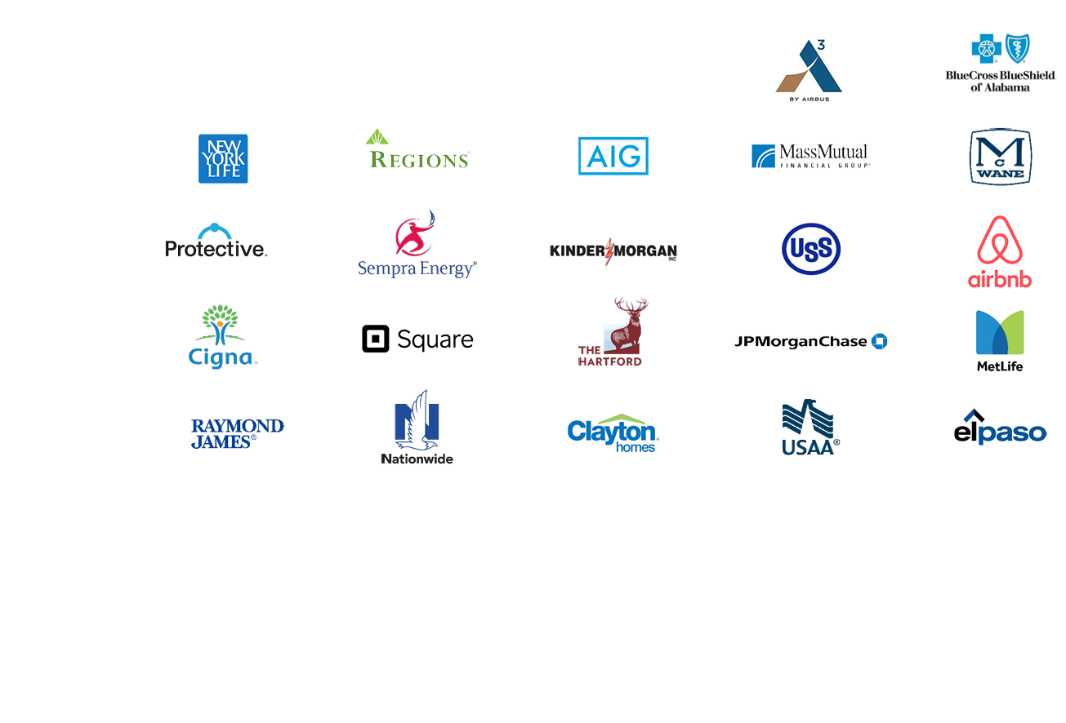
WHO WE ARE
OUR CLIENT BASE
KEY INDUSTRIES SERVED
• Admiralty and Maritime
• Automotive and Aerospace
• Agriculture
• Autonomy and Robotics Systems
• Banking and Financial Services
• Defense and Aviation
• Energy, Utilities, and Natural Resources
• Fintech
• Governmental Entities
• Health Care
• Higher Education
• Industrial, Manufacturing, and Distribution
• Insurance
• Internet of Things (IoT)
• Life Sciences
• Manufacturing
• Medical Devices
• Non-Profit
• Outdoor Products
• Personalized Medicine and Genomics
• Real Estate
• Senior Living and Long-Term Care
• Sports and Entertainment
Notes:
[Brandon]

Slide 7
HIGHER EDUCATION PRACTICE
The Higher Education Practice Group is deeply experienced in all manner of regulatory issues that are important to institutions, investors, third-party servicers, and accrediting agencies.
Title IV | Accreditation | State Licensure
Cybersecurity | False Claims Act | Title IX
Transactions | Government Relations | Government Investigations
Notes:
[Brandon]

Slide 8
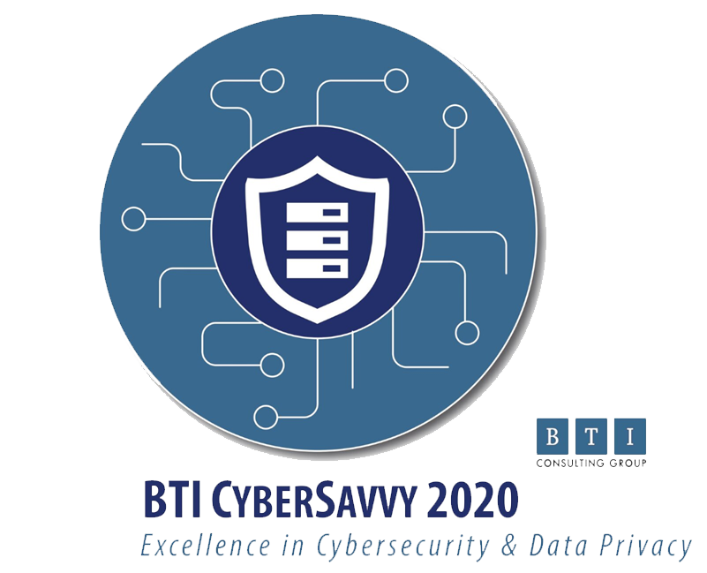


NATIONALLY RANKED CYBERSECURITY & PRIVACY PRACTICE
Notes:
[Adam]

Slide 9
Recent Cyber Trends
Ransomware attacks and extortion attacks have been rampant.
Business email compromise schemes continue to plague organizations of all industries.
Data breach costs continue to grow. Average cost of a data breach in 2020 in the education sector was $3.9M.
Notes:
[Adam]

Slide 10
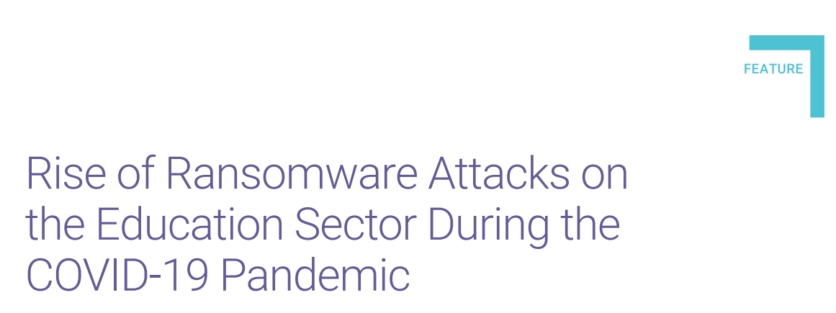
Recent Cyber Trends
https://www.isaca.org/resources/isaca-journal/issues/2021/volume-5/rise-of-ransomware-attacks-on-the-education-sector-during-the-covid-19-pandemic
Notes:
[Adam]
Lots of articles – ransomware in particular on the rise during COVID, has not abated
Reasons why

Slide 11
Institutions are Targeted by Cyber Criminals
They collect and store a high volume of sensitive data (financial, health, PII).
The operational impact of a cyber attack could be crippling. . . and criminals know this.
Without critical systems, you may be unable to:
  Hold classes
  Process payments
  Pay employees
  Process grades
  Communicate with students and faculty
Increased vulnerabilities due to COVID-19.
Notes:
[Adam]

Slide 12
Common cyber incidents
Target student PII to resell on the black market.
Encrypting school system data for ransom.
Target student direct deposit information to redirect financial aid reimbursements to attacker bank accounts.
IRS impersonation scam that appears to primarily target educational institutions.
Notes:
[Adam]

Slide 13
Electronic Announcement
GENERAL-22-02 StopRansomware.gov website
  The Federal Government launched a website to help public and private organizations defend against the rise in ransomware cases. StopRansomware.gov.
  StopRansomware.gov is an interagency resource that provides FSA partners and stakeholders with ransomware protection, detection, and response guidance that they can use on a single web.
  FSA encourages IHEs to use this new website to understand the threat of ransomware, mitigate risk, and know what steps to take in the event of an attack.
  Link to the Electronic Announcement
Notes:
[Adam]

Slide 14
GLBA OVERVIEW
Gramm-Leach-Bliley Act (GLBA) was enacted in 1999 (Pub. L. No. 106-102)
    GLBA requires financial institutions to provide customers with information about the institutions’ privacy practices and about their opt-out rights, and to implement security safeguards.
    Subtitle A of Title V of the GLBA requires the FTC to issue regulations requiring financial institutions to develop standards relating to physical safeguards for certain information.
Notes:
[Brandon]

Slide 15
Program Participation Agreement
Institutions of higher education agree to comply with the GLBA, Safeguards Rule.
“Institutions are strongly encouraged to inform its students and the Department of any breach.”
“The Secretary considers any breach to the security of student records and information as a demonstration of a potential lack of administrative capability.”
Notes:
[Brandon]

Slide 16
Applicable Department Regulations
Administrative Capability (34 C.F.R. § 668.14)
  To begin and continue participation in Title IV programs, an institution must maintain appropriate institutional capability for the sound administration of Title IV programs.
    The maintenance of adequate checks and balances in IHEs systems of internal control.
Notes:
[Brandon]

Slide 17

GLBA Audit
Added to the Compliance Supplement and OIG Audit Guide in 2019.
Audit Procedures
  Verify that the institution has designated an individual to coordinate the information security program.
  Verify that the institution has performed a risk assessment that addresses the three required areas
    Employee training
    Information systems
    Detecting, preventing, and responding to attacks
  Verify that the institution has documented a safeguard for each risk identified from step b above.
Notes:
[Brandon]

Slide 18
SAIG
Federal Student Aid Application Systems (e.g. COD & NSLDS)
Must ensure that Title IV data is protected from access by or disclosure to unauthorized personnel
The SAIG Enrollment Agreement requires schools to immediately notify the Department of a breach
GLBA compliance requirement
Institutions’ point of contact information
Notes:
[Brandon]

Slide 19
GLBA Overview
GLBA applies to the handling of “customer information” by financial institutions.
GLBA applies to entities engaged in “financial activities”
  Postsecondary institutions are considered financial institutions by the FTC.
GLBA is enforced by the FTC for non-banking financial institutions.
Notes:
[Brandon]

Slide 20
GLBA Overview
Previously, GLBA required a financial institution to:
  Develop, implement, and maintain a written information security program;
  Designate the employee(s) responsible for coordinating the information security program;
  Periodically evaluate and update your school’s security program;
Notes:
[Brandon]

Slide 21
Current Rule
Previously, GLBA required a financial institution to:
  Identify and assess risks to customer information; and
  Select appropriate service providers that are capable of maintaining appropriate safeguards.
Notes:
[Brandon]

Slide 22
RULEMAKING
The FTC is required to periodically review all of its rules and guidance.
On September 7, 2016, the FTC published a Request for Public Comment.
  The FTC requested public comments on “the economic impact and benefits of the Rule; possible conflict between the Rule and state, local, or other federal laws or regulations; and the effect on the Rule of any technological, economic, or other industry changes.”
The FTC received 28 public comments, including by the American Council on Education.
Notes:
[Brandon]

Slide 23
Final Rule
On December 9, 2021, the FTC issued a Final Rule to amend the GLBA, Safeguards Rule. (86 FR 70272) https://www.govinfo.gov/content/pkg/FR-2021-12-09/pdf/2021-25736.pdf
The Final Rule is intended to “that strengthens the data security safeguards that financial institutions are required to put in place to protect their customers’ financial information.”
The FTC’s Commission voted 3-2 to adopt the final revisions to the Rule.
Notes:
[Brandon]
Extended the deadline for comments to two years

Slide 24
Final Rule
Statement by Chair Lina M. Khan
  “The amendments adopted today require financial institutions to develop information security programs that can meet the challenges of today’s security environment.”
  “Despite the increasing sophistication of cyberattacks, many businesses continue to offer inadequate security.”
Dissenting statement by Commissioners Joshua Phillips and Christine Wilson
  “[T]he new prescriptive requirements could weaken data security by diverting finite resources towards a check-the-box compliance exercise and away from risk management tailored to address the unique security needs of individual financial institutions.”
Notes:
[Brandon]

Slide 25
Key changes
  The Final Rule requires that financial institutions prepare a written risk assessment. This assessment must include or address each of the following items:
    Criteria for evaluating identified risks faced by the financial institution;
    Criteria for the assessment of the confidentiality, integrity, and availability of the financial institution’s information systems and customer protection; and
    How identified risks will be mitigated or accepted based on the risk assessment and how the information security program will address the financial institution’s risk.
Notes:
[Brandon]

Slide 26
Key changes
Incident response plan:
  The Final Rule requires financial institution to develop and implement an incident response plan.
  Incident response plan must address::
    Goals of the plan
    Processes for responding to a security event
    Roles and responsibilities
    Information sharing
    Remediation of any identified weakness
    Documenting and reporting security events
    Evaluating and revising response to plan following security event
Notes:
[Adam]

Slide 27
Key changes
The Final Rule requires financial institutions to design and implement safeguards to control risks, including by:
  Implementing and periodically reviewing access controls, including technical and physical controls;
  Encrypting all customer information held or transmitted by a financial institution both in transit over external networks and at rest;
  Identifying and managing the data, personnel, devices, systems, and facilities that enable a financial institution to achieve business purposes in accordance with their relative importance to their business objectives and risk strategy;
Notes:
[Adam]
Telling what to do from a technology

Slide 28
Key changes
The Final Rule requires financial institutions to design and implement safeguards to control risks, including by (cont’d):
  Implementing multi-factor authentication for any individual accessing any information system;
  Developing, implementing, and maintaining procedures for the secure disposal of customer information; and
  Implementing policies, procedures, and controls designed to monitor and log the activity of authorized users and detect unauthorized access or use of, or tampering with, customer information by such users.
Notes:
[Adam]

Slide 29
Key changes
Financial institutions must designate a qualified individual responsible for overseeing and implementing a financial institutions information security program and enforcing their information security program.
  Qualifications will depend upon the size and complexity of a financial institution’s information system and the volume and sensitivity of the customer information that the financial institution possesses or processes.
  A Chief Information Security Officer title is not required.
Notes:
[Brandon]

Slide 30
Key changes
The qualified individual must submit an information security report in writing, regularly and at least annually, to a financial institution’s board of directors or equivalent governing body.
The report shall include the following information:
  The overall status of the information security program and the financial institution’s compliance with the Rule; and
  Material matters related to the information security program, addressing issues such as risk assessment, risk management and control decisions, service provider arrangements, results of testing, security events or violations and management’s responses thereto, and recommendations for changes in the information security program.
Notes:
[Brandon]

Slide 31
Key changes
Training requirements include:
  Providing personnel with security awareness training that is updated as necessary to reflect risks identified by the risk assessment;
  Utilizing qualified information security personnel employed by the financial institution or service provider sufficient to manage information security risks and to perform or oversee the information security program;
  Providing information security personnel with security updates and training sufficient to address relevant security risks; and
  Verifying that key information security personnel take steps to maintain current knowledge of changing information security threats and countermeasures.
Notes:
[Brandon]

Slide 32
Key changes
Expands the definition of “financial institution” to include entities engaged in activities that the Federal Reserve Board determines to be incidental to financial activities.
  This change adds “finders”—companies that bring together buyers and sellers of a product or service within the scope of the Rule.
Notes:
[Brandon]

Slide 33
Key changes
Requires financial institutions to “periodically assess” their service providers on an ongoing basis.
  Continues the requirements to based on the risk they present and the continued adequacy of their safeguards.
Notes:
[Adam]

Slide 34
Key changes
Small businesses
  The Final Rule exempts financial institutions that collect information about fewer than 5,000 consumers from the:
    Written risk assessment
    Incident response plan
    Annual reporting requirements
Notes:
[Brandon]

Slide 35
Effective Date
This Final Rule became effective on January 10, 2022.
However, certain provisions will become effective on December 9, 2022.
  Provisions include:
    Appointment of a qualified Individual
    Written risk assessments
    Written incident response plan
Notes:
[Brandon]

Slide 36
Supplemental Notice
  Notification requirement
    The FTC is issuing a Supplemental Notice of Proposed Rulemaking that proposes adding a requirement financial institutions notify the FTC of detected security events under certain circumstances.
Notes:
[Brandon]

Slide 37
Other issues
  The FTC declined to incorporate or reference NIST standards.
  Institutions of higher education continue to be considered “financial institutions.”

Slide 38
Impact in Higher Education
The U.S. Department of Education will require compliance with the revised Rule.
Changes will be incorporated into your annual compliance audit.
Costs of compliance are borne by the institution
Notes:
[Brandon]

Slide 39
GLBA NON-COMPLIANCE
FTC
  Fines
  Consent agreement
Notes:
[Brandon]

Slide 40
GLBA NON-COMPLIANCE
U.S. Department of Education
  Loss of access to FSA systems
  Initiation of a Termination Action
  Denial of an Open Recertification Action
  Initiation of a Limitation Action
  Imposition of a Fine action
  Placement on HCM
Notes:
[Brandon]

Slide 41
FUTURE COMPLIANCE CONSIDERATIONS
NIST SP 800-171 compliance
New cybersecurity program at the U.S. Department of Education
Notes:
[Brandon]

Slide 42
Next Steps
Recommendations for institutions in light of the Final Rule:
  Conduct a holistic risk assessment.
  Ensure the board of directors and executive leadership is familiar with the Final Rule’s requirements and understands the need to implement new measures.
Notes:
[?]

Slide 43
RESOURCES
Final Rule
Dear Colleague Letters: GEN 16-12 , GEN 15-18
Electronic Announcement: Protecting Student Information – Compliance with CUI and GLBA
FSA Handbook
NIST SP 800-171
Notes:
[Brandon]

Slide 44

QUESTIONS?

Slide 45

Presenters
Brandon S. Sherman
BSherman@maynardcooper.com
202.868.5925
Adam Griffin
AGriffin@maynardcooper.com
205.415.4903

Slide 46
THANK YOU

