Slide 1
Federal Regulatory Legislative Updates
DEAC Fall Workshop
Scottsdale, Ariz.
October 24, 2022
Brandon S. Sherman

Slide 2
Presenter Background
Brandon Sherman
Practice and Experience
  Previous Experience: Senior Counsel to the Deputy Secretary
  Advises institutions on meeting U.S. Department of Education cybersecurity requirements
  Counsels clients on the rules and procedures related to federal financial aid, accreditation, Title IX, and transactional issues
Contact Information
  Bsherman@maynardcooper.com
  (202) 868-5925

Slide 3
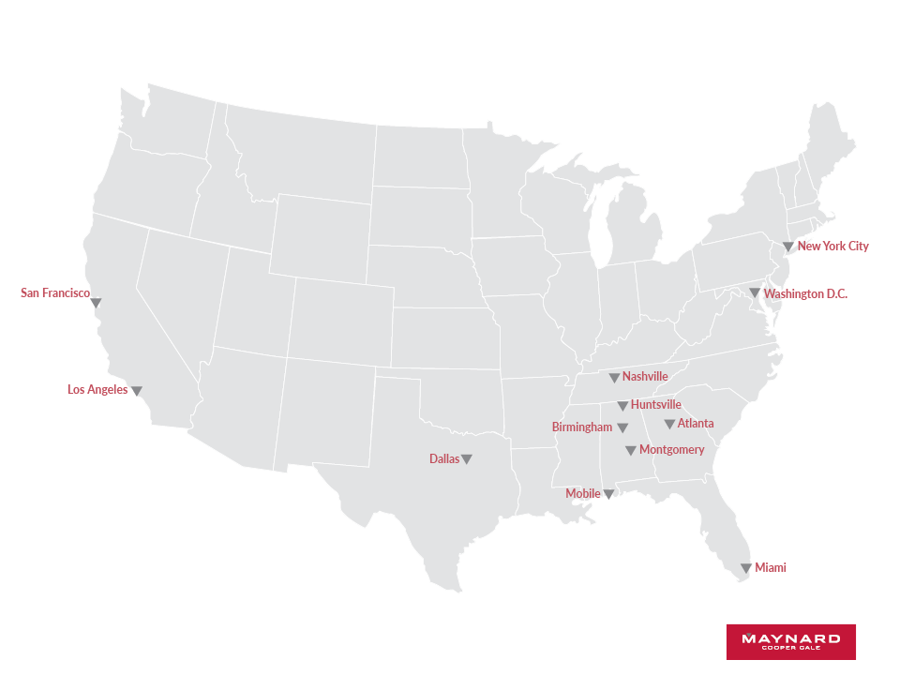
Twelve Offices Coast to Coast

Slide 4
HIGHER EDUCATION PRACTICE
Maynard’s Higher Education Practice Group is deeply experienced and entrenched in all facets of regulatory issues that are important to institutions, investors, third-party servicers and accrediting agencies.
Title IV
Accreditation
Cybersecurity
False Claims Act
Transactions
Government Relations
Government Investigations
Title IX
State Licensure

Slide 5
LEGAL DISCLAIMER
The purpose of this presentation is to provide news and information on legal and regulatory issues, and all content provided is for informational purposes only. It should not be considered legal advice.
The transmission of information from this presentation does not establish an attorney-client relationship with the participant or reader. The participant or reader should not act on the information contained in this presentation or any accompanying materials without first consulting retained legal counsel.
If you desire legal advice for a particular situation, you should consult an attorney.

Slide 6
TOPICS
Accreditation
Negotiated Rulemaking
U.S. Department of Education Updates
Congress
Cybersecurity
Federal Trade Commission

Slide 7

U.S. Department of Education
Key Staff:
  Secretary of Education: Miguel Cardona
  Under Secretary: James Kvaal
  Deputy Under Secretary: Ben Miller
  Chief Operating Officer, Federal Student Aid: Richard Cordray
  Assistant Secretary for Postsecondary Education: Nasser Paydar
  Assistant Secretary for Civil Rights: Catherine Lhamon
Jun 16, Jkt 256001 PO 00000 N1 lotter on DSK11XQN23PROD with NOTICES1

Slide 8
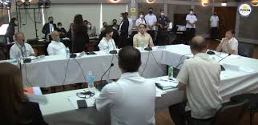
Policy Shift
Focus on student debt, student outcomes, equity, and accountability issues
Policy changes through rulemaking, guidance, and litigation
Enforcement is a priority for FSA
Accreditation-Return to the regional/national accreditor distinction

Slide 9
Accreditation

Slide 10

Florida and Accreditation
Florida -SB 7044:
  The bill prohibits a public postsecondary institution from being accredited by the same accrediting agency or association for consecutive accreditation cycles.
  Institutions must seek accreditation from identified regional accreditors and if they are denied by the regional accreditor, they may seek accreditation from any USDOE-approved accreditor that is different from their current accreditor.
  The bill authorizes a public postsecondary institution to remain with its current accrediting agency or association if the institution is not granted candidacy by an accrediting agency or association before its next reaffirmation or fifth-year review date.
  “Prior to this legislation, accrediting agencies had a monopoly on Florida colleges and universities and were able to hold a hand over the operations of educational institutions and remove objectivity from the process.” Press release from Gov. Ron DeSantis.

Slide 11
ED Accreditation
Accrediting Council for Independent Colleges and Schools (“ACICS”)
  On December 12, 2016, Secretary King terminated ACICS’s recognition
    The decision was reversed by Secretary DeVos, granting the agency one year to come into compliance with the recognition criteria
      Secretary DeVos concluded that the previous administration did not consider the full record
  On June 2, 2021, the SDO terminated ACICS’s recognition
    The SDO found that ACICS failed to meet the recognition criteria relating to accreditation standards, application of standards in reaching an accreditation decision, ensuring consistency in decision-making, and monitoring and reevaluation of accreditation institutions

Slide 12
ED Accreditation
Accrediting Council for Independent Colleges and Schools (“ACICS”)
  On Aug. 19, 2022, the Deputy Secretary denied ACICS’s appeal.
    As a result, ACICS’s recognition was terminated.
  On September 6, 2022, ACICS announced that they will be shutting down by March 2024.
Notes:
Cardona made prejudicial statements

Slide 13
Negotiated Rulemaking

Slide 14
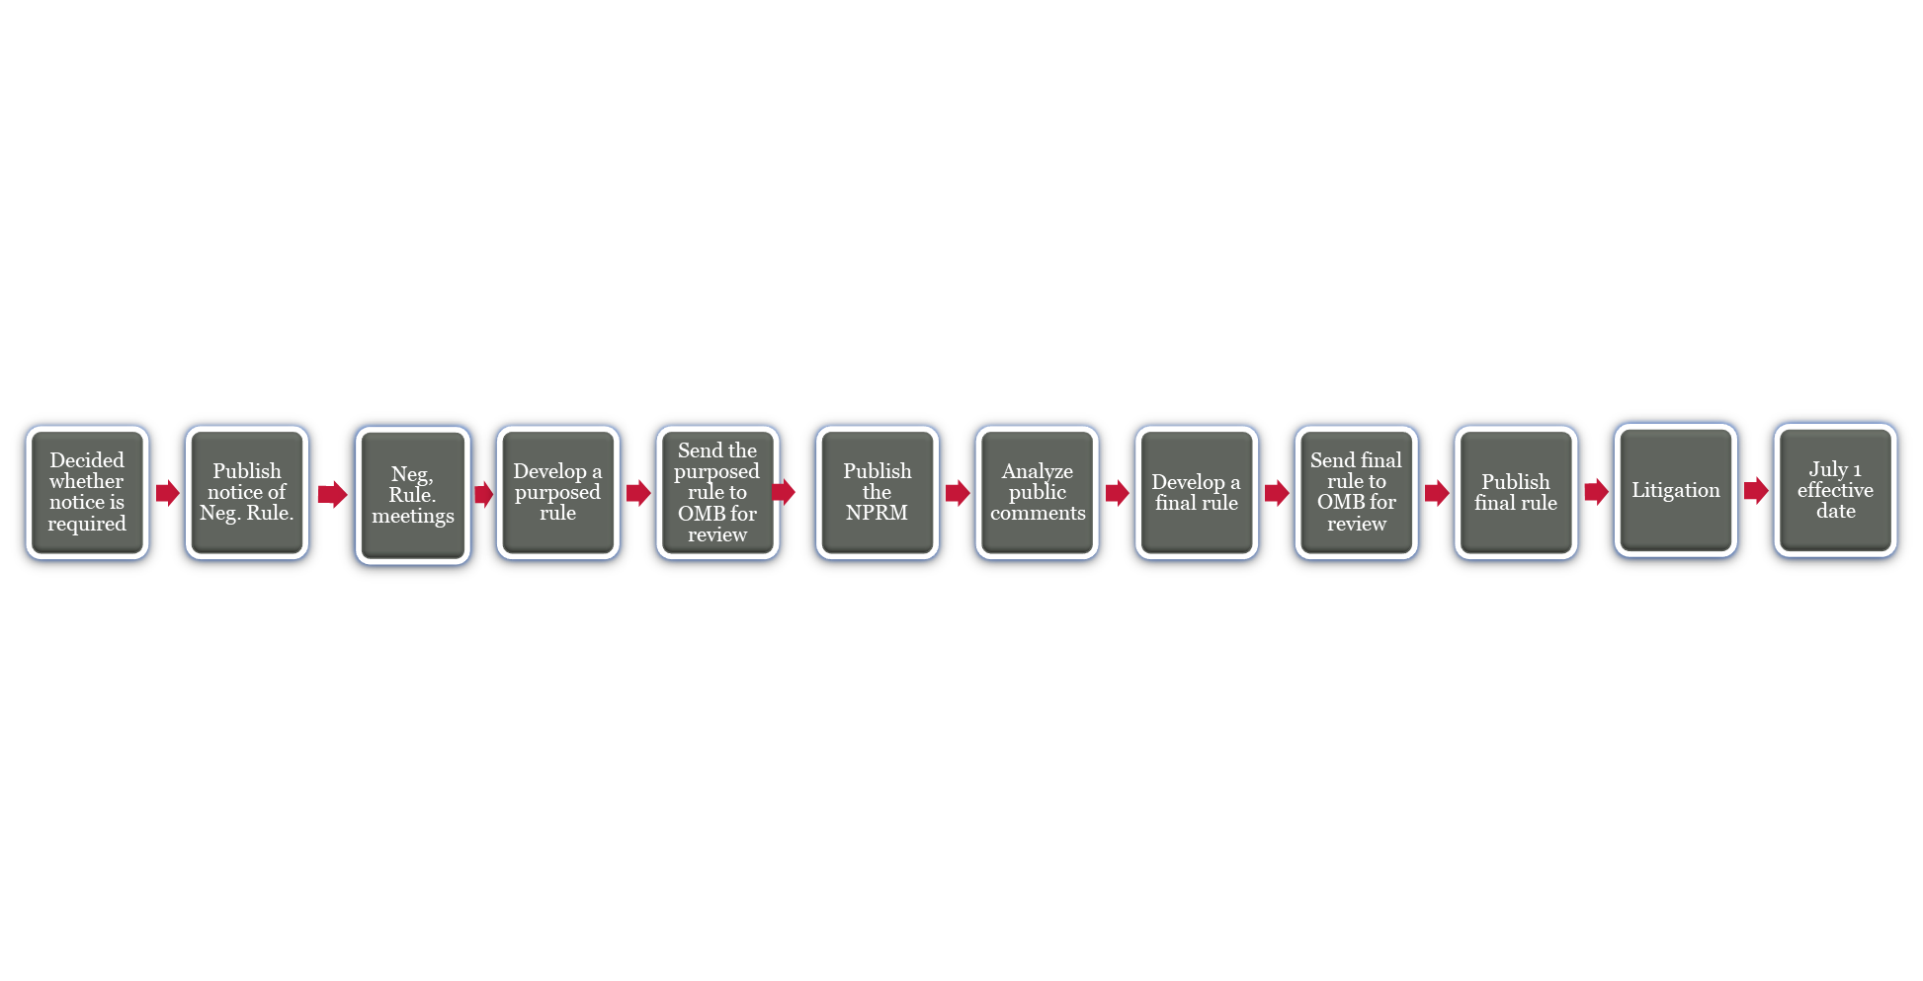
Regulatory Process

Slide 15
Negotiated rulemaking
Under Negotiated Rulemaking procedures, when consensus is reached, ED is obligated to issue proposed regulations consistent with the agreement reached by the negotiators.
If even one negotiator objects, then consensus is not reached.
If consensus is not reached, ED is free to issue proposed regulations as it sees fit, including without regard to any position it took during negotiations.

Slide 16
Negotiated rulemaking
If consensus was reached, ED’s efforts hue closely to the agreed language.
Once ED has worked out proposed regulations among its internal constituencies, it forwards the proposals to the Office of Management and Budget’s Office of Information and Regulatory Affairs (“OIRA”) for review.

Slide 17
A Little Background
Beginning in 2010, the Obama Administration issued a series of new regulations under the general heading of Program Integrity, including:
  Gainful Employment
  Misrepresentation
  State Authorization
  Incentive Compensation
In 2016, the Obama Administration issued revised Borrower Defense to Repayment (“BDR”) regulations.

Slide 18
A Little Background
Several of the Obama regulations were challenged in court.
Trump Administration set aside several of the Obama regulations and undertook its own rulemaking:
  It delayed and ultimately canceled the Gainful Employment regulations.
  It delayed the Obama BDR regulations until it was forced to implement them by the court in October 2018.
  It issued new BDR regulations in 2019 that became effective on July 1, 2020.
  It issued expanded Title IX regulations that became effective on August 14, 2020.

Slide 19
biden administration plans
The Biden Administration in early 2021 announced its intention to undertake new rulemaking in several key areas.
On May 17, 2021, the Department of Education’s Office for Civil Rights (“OCR”) announced that it would hold virtual hearings in the first step toward revising the Trump Administration’s Title IX regulations:
  Because Title IX does not deal with federal student aid matters, it is not subject to Negotiated Rulemaking and therefore is outside the scope of this presentation.

Slide 20
biden administration plans
On May 24, 2021, ED announced that it would convene several Negotiated Rulemaking committees focusing on various issues centered on affordability, accountability and federal student loans.
ED also announced a series of hearings to help it settle on a list of specific topics to be covered in the rulemaking.

Slide 21
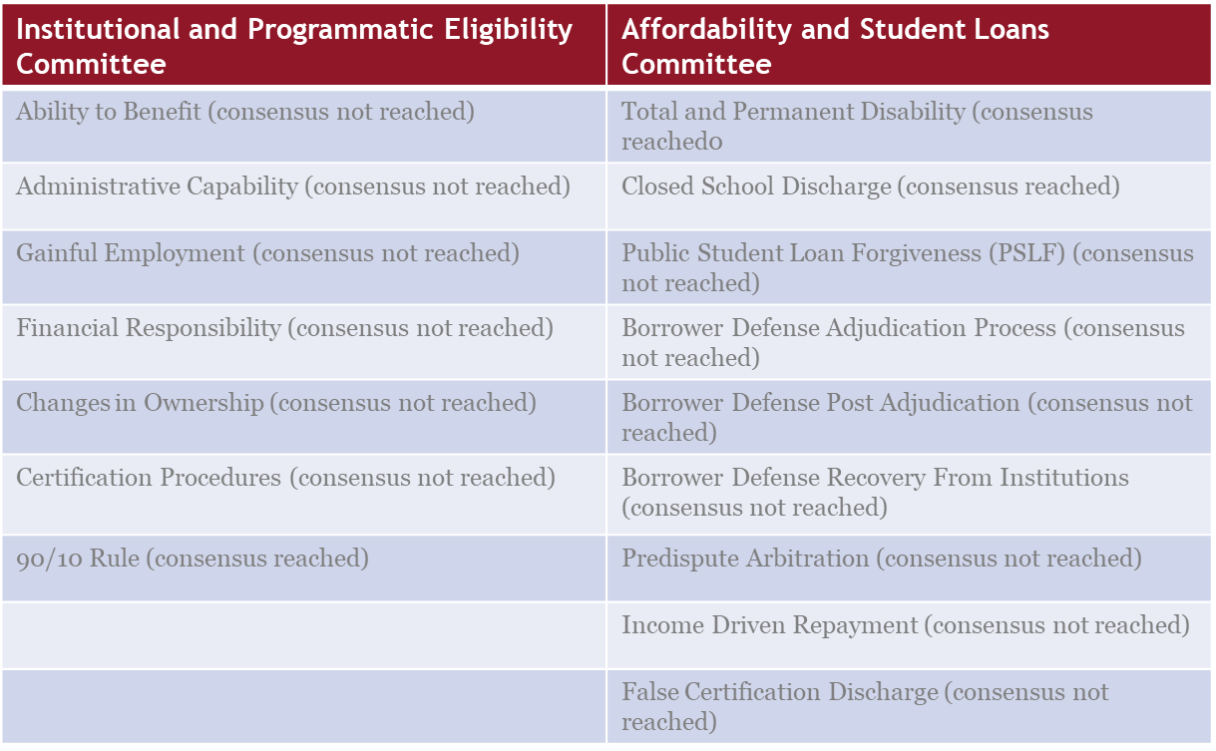
Negotiated rulemaking

Slide 22
Negotiated rule making
Effective at the earliest July 1, 2023:*
  Total and Permanent Disability
  Closed School Discharge
  Eliminate Interest Capitalization
  PSLF
  Borrower Defense
  Predispute Arbitration
  False Certification Discharge
  Change in Ownership
  90/10 Rule
  * Per Master Calendar statutory requirements, a final rule must be published by November 1 in order to be effective July 1 of the following year.

Slide 23
Negotiated rule making
Effective at the earliest July 1, 2024:*
  Gainful Employment
  Factors of Financial Responsibility
  Standards of Administrative Capability
  Certification Procedures
  Ability to Benefit
  Income Driven Repayment
  * Per Master Calendar statutory requirements, a final rule must be published by November 1 in order to be effective July 1 of the following year.

Slide 24
BORROWER DEFENSE TO REPAYMENT
ED released an unofficial version of the NPRM on July 6, 2022.
The official version of the NPRM was published in the Federal Register on July 13, 2022.
The official publication triggered a 30-day comment period.

Slide 25
BORROWER DEFENSE TO REPAYMENT
The proposal makes significant changes to the current regulations:
  Applies a single set of standards to all BDR applications pending on or submitted after July 1, 2023, no matter when the loan was disbursed.
  Re-establishes opportunity for ED to resolve claims as a group, including at the request of State Attorneys General and state licensing and authorizing agencies.

Slide 26
BORROWER DEFENSE TO REPAYMENT
Identifies categories of activities or events that would support a BDR claim:
  Substantial misrepresentation
  Substantial omissions of fact
  Breach of contract
  Aggressive or deceptive recruitment
  Institution was subject to a final State or Federal court or administrative judgment or final ED action for one or more activities that would form the basis of a BDR complaint
Deems a misrepresentation to be substantial if a borrower relied on or could reasonably be expected to rely on it to the borrower’s detriment.
Presumes that a borrower reasonably relied on a misrepresentation.

Slide 27
BORROWER DEFENSE TO REPAYMENT
Prohibits aggressive and deceptive recruiting:
  Can be conducted by the school, any of its representatives, or any person or entity with which the school has an agreement regarding the provision of educational, marketing, advertising, lead generation, recruiting, or admissions services.
  Penalties for institutions found to have engaged in aggressive and deceptive recruiting could include the revocation of PPAs for provisionally certified schools and limitations or other adverse actions.

Slide 28
BORROWER DEFENSE TO REPAYMENT
Defines aggressive and deceptive recruiting as:
  Demanding or pressuring applicants to make enrollment and loan decisions immediately, including on first day of contact
  Falsely claiming that enrollment opportunities are limited
  Taking advantage of applicants’ lack of knowledge about schools, programs and loans
  Discouraging applicants from consulting friends or family prior to making enrollment or borrowing decisions
  Failing to provide applicants with requested information about the program, costs, and the availability of aid
  Obtaining applicant contact information through false means
  Using abusive or threatening language toward applicant
  Repeatedly contacting applicant who has requested no further contact

Slide 29
BORROWER DEFENSE TO REPAYMENT
Sets burden of proof for a BDR claim as preponderance of the evidence, or more likely than not
Does not establish a statute of limitations for BDR claims
Establishes timeline in which it must adjudicate a claim. If no decision rendered by the end of the timeline, the loans are “unenforceable”
Presumes that borrowers with approved BDR claims should receive full discharge of loan liabilities unless ED can rebut the presumption by a preponderance of the evidence

Slide 30
BORROWER DEFENSE TO REPAYMENT
Does not establish a right for institutions to appeal discharge decisions
Expands ED’s recoupment authority and establishes a recoupment process
Requires ED generally to commence proceedings to recoup discharged amounts from institutions within 6 years after the borrower’s last date of attendance at the institution, except this limitation does not apply if ED has notified the institution of the borrower’s BDR claims before the end of the 6-year period

Slide 31
DISPUTES, MANDATORY ARBITRATION AND CLASS ACTION WAIVERS
Prohibits required completion of any internal dispute resolution process prior to filing a complaint based on a BDR claim with an accreditor or applicable government agency.
Bans the use of mandatory pre-dispute arbitration agreements and class action waivers for any BDR claim for any Direct Loan recipients.
Requires institutions to file judicial and arbitration records related to BDR claims with ED that ED must publish in a central public database.

Slide 32
Closed school DISCHARGE
Eligibility – Any borrower enrolled on the date of the campus closure or at any time in the 180 days prior to closure who:
  Did not complete the program at the closed school, or
  Did not complete a teachout agreement at another school that was approved by the accrediting agency and, if applicable, the state regulatory agency
School – The main campus and any of its branches or additional locations

Slide 33
Closed school DISCHARGE
Closure Date – The date the Secretary determines the school stopped providing instruction in most of its programs
Allows ED to discharge loans for eligible borrowers without application
Expands list of exceptional circumstances justifying an extension of 180-day lookback period, including a host of regulatory and accreditation actions

Slide 34
Closed school DISCHARGE
Borrower chooses whether to participate in a teachout agreement or take discharge
Borrower remains eligible for discharge even if borrower completes the program at an institution outside of an approved teachout agreement
If borrower accepts but does not complete a teachout under an approved teachout agreement, ED will discharge the loan within one year of the borrower’s last day of attendance at the teachout school

Slide 35
FALSE CERTIFICATION DISCHARGE
Eligibility - Borrower who is not a high school graduate or the equivalent is eligible for discharge if the school:
  Falsified the borrower’s high school graduation status
  Falsified the borrower’s high school diploma
  Referred the borrower to a third party to obtain a falsified high school diploma
Streamlines and simplifies the process for seeking such discharges
May grant a false certification discharge without an application due to falsification of Satisfactory Academic Progress for all loans.

Slide 36
90/10 Rule & Changes in Ownership
ED released an unofficial version of the NPRM on July 26, 2022.
The official publication triggered a 30-day comment period.
On October 19, 2022, the Office of Management and Budget concluded its review of the final rule.
The final rule is expected to be published in the coming days.

Slide 37
90/10 Rule
Includes other sources of federal revenue, in addition to title IV revenue from the Department in the calculation that proprietary institutions make to determine if they are in compliance with the 90/10 rule.
The proposed rule does not define in regulation the phrase “Federal educational assistance funds.”
  Instead, the Department would publish a list of such programs in the Federal Register and notify institutions as needed.

Slide 38
Institutional and Programmatic Eligibility Committee
Change of Ownership
  Revises the existing definition of “nonprofit institution” to clarify that no part of net earnings may benefit a natural person or private entity
  Requires an institution to seek a preliminary review of a proposed change in ownership transaction no later than 90 days before the transaction occurs
  Increases the reporting requirements in instances that a change in ownership does not constitute a change of control

Slide 39
Institutional and Programmatic Eligibility Committee
  Administrative Capability:
    To provide adequate career services
    To make reasonable efforts to provide students with clinical or externship opportunities required for completion of a credential or licensure in the recognized occupation
    To not engage in misrepresentation or aggressive recruitment

Slide 40
Institutional and Programmatic Eligibility Committee
Gainful Employment:
  To re-establish and update the 2014 GE regulations and include:
    A new earnings threshold metric
    Modifications to both the numerator and dominator of the eligibility equation
    Eliminates an institution’s ability to challenge or appeal data
    Changes to the CIP Code classification used to determine programs
Financial Responsibility:
  To revise the set of conditions that automatically requires the posting of financial protection
  To revise the set of conditions that may require the posting of financial protection
    Including accreditor actions
  To clarify that the Department may independently assess whether the auditor’s concerns have been addressed or whether the opinion of doubt reflects a lack of financial responsibility

Slide 41
U.S. Department of Education Updates

Slide 42
Title IX
Title IX of the Education Amendments of 1972 (“Title IX”)
  NPRM issued on June 23, 2022
  The proposed rule:
    Would not require a live hearing for evaluating evidence
    Would permit the “single-investigator” model
    Would not require cross-examination by the parties for this purpose but would permit a postsecondary institution to use cross-examination if it so chooses or is required to by law
    Would clarify that Title IX’s protections against discrimination based on sex apply to discrimination based on sexual orientation and gender identity.
    Would clarify that Title IX’s prohibition of discrimination based on sex includes protections against discrimination based on sex stereotypes and pregnancy.

Slide 43
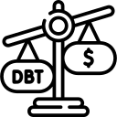
Student debt
Student debt relief
Student loan payment “pause period” extended to January 1, 2023
Sweet v. Cardona

Slide 44

Other ED Announcements
PPA signature requirement
Other expected regulatory changes:
  Family Educational Rights and Privacy Act (“FERPA”)
  Religious Liberty and Free Inquiry Rule
  Workforce Innovation and Opportunity Act (“WIOA”)

Slide 45
Congress

Slide 46
Congress
  The Build Back America Better Act (H.R. 5376)
  HEA reauthorization
  Potential impact of the November election

Slide 47
Cybersecurity

Slide 48
glba overview
GLBA applies to the handling of “customer information” by financial institutions.
GLBA applies to entities engaged in “financial activities”
  Postsecondary institutions are considered financial institutions by the FTC
GLBA is enforced by the FTC for non-banking financial institutions
PPAs have a GLBA compliance requirement

Slide 49
Revised glba
Changes to GLBA
  The updated rule requires a financial institution to:
    Prepare a written risk assessment
    Design and implement safeguards to control risks
    Designate a qualified individual responsible for overseeing and implementing a financial institution’s information security program
    Submit an information security report in writing, regularly and at least annually, to a financial institution’s board of directors
  All new requirements must be implemented by December 9, 2022
  16 C.F.R. Part 314

Slide 50
Federal Trade Commission

Slide 51

Federal trade commission
The FTC enforces section 5(a) of the FTC Act, 15 U.S.C. § 45(a), which prohibits unfair or deceptive acts or practices in or affecting commerce
  “Deceptive” practices are defined in the FTC’s Policy Statement on Deception as involving a material representation, omission or practice that is likely to mislead a consumer acting reasonably in the circumstances
“The FTC has broad authority to target unfair and deceptive practices in the for-profit school sector, but its approach has varied over the years” (former FTC Commissioner Rohit Chopra)
Notes:
Brandon

Slide 52
SECTION 5 AUTHORITY
Under section 5 of the Federal Trade Commission Act, the FTC can seek civil penalties if it proves that:
  The company knew the conduct was unfair or deceptive in violation of the FTC Act; and
  The FTC had already issued a written decision that such conduct is unfair or deceptive.
Notes:
Brandon

Slide 53
New approach
In October 2021, the FTC announced that it is making a number of critical changes to its approach to address “the rampant abuse of students, veterans, their families, and taxpayers” by for-profit colleges
CHANGES INCLUDE:
  The FTC is resurrecting its Penalty Offense Authority, found in section 5 of the FTC Act.
  “FTC will be enhancing its enforcement cooperation with other oversight agencies.”
    “FTC investigations can assist the Department of Education in taking additional administrative actions against those that violate the law”

Slide 54

Prohibited practices
The FTC determined that the following acts or practices are deceptive or unfair and, thus, are unlawful under Section 5 of the Federal Trade Commission Act:
    To misrepresent the demand for people who have graduated from, or completed courses at, a specific institution;
    To misrepresent graduates’ employment prospects, the ease with which they’ll be able to get a job, or the employment opportunities in any field in which a course of instruction is offered;
    To misrepresent the types of jobs available to graduates or for which they would be qualified;

Slide 55
Prohibited practices
The FTC determined that the following acts or practices are deceptive or unfair and, thus, are unlawful under Section 5 of the Federal Trade Commission Act:
  To misrepresent the number or percentage of people attending any course or completing any program or degree who have obtained employment, or the field or nature of that employment;
  To misrepresent how much grads will or may earn;
  To misrepresent the qualifications necessary to get jobs in the fields for which an institution offers training, including whether experience or additional education is required or advantageous; and
  To misrepresent the institution’s capabilities for helping students find employment or the assistance actually given to grads, including the existence of job placement services.

Slide 56








Actions to take Now
Gather and evaluate any materials in which claims are made about the demand for, or outcomes of, graduates.
Focus is on publicly available information.
Don’t forget lead aggregators and marketing agencies!
 | Internet ads/search engine optimization |  | School catalog
 | Call scripts |  | Vendor contracts
 | School website |  | Partnership agreements
 | Television/radio ads |  | Social media
Notes:
Roger

Slide 57
RESOURCES
Borrower Defense to Repayment NPRM (7-13-22)
ED Press Release (7-6-22)
ED Fact Sheet
FTC Vocational School Guides:
https://www.ftc.gov/sites/default/files/documents/federal_register_notices/2013/11/131118vocationalschools.pdf
FTC Digital Advertising Disclosure Guidelines:
https://www.ftc.gov/sites/default/files/attachments/press-releases/ftc-staff-revises-online-advertising-disclosure-guidelines/130312dotcomdisclosures.pdf

Slide 58

QUESTIONS?

Slide 59
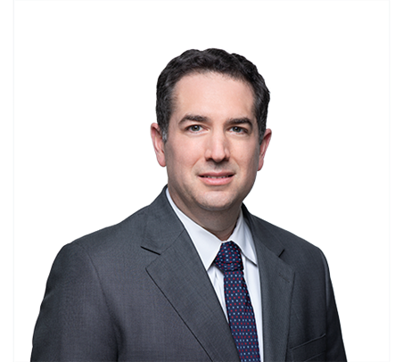
Contact information
202.868.5925
bsherman@maynardcooper.com

Slide 60
THANK YOU

