Slide 1
FTC’S INITIATIVE ON INSTITUTIONAL MARKETING PRACTICES —
What You Need to Know
CAPPS 38th Annual Conference
La Jolla, California
October 6, 2022

Slide 2
LEGAL DISCLAIMER
The purpose of this presentation is to provide news and information on legal and regulatory issues, and all content provided is for informational purposes only. It should not be considered legal advice.
The transmission of information from this presentation does not establish an attorney-client relationship with the participant or reader. The participant or reader should not act on the information contained in this presentation or any accompanying materials without first consulting retained legal counsel.
If you desire legal advice for a particular situation, you should consult an attorney.
Notes:
Brandon

Slide 3
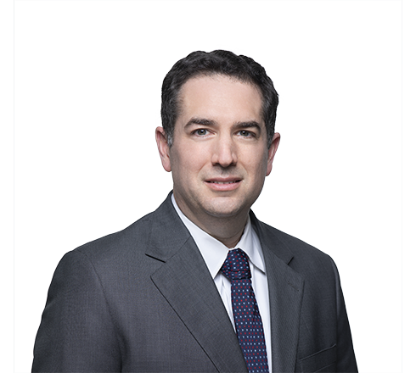
Brandon Sherman’s Background
PRACTICE AND EXPERIENCE
  Member of Maynard Cooper & Gale’s Higher Education Practice Group with more than 17 years of experience
  Previously served as Senior Counsel to the Deputy Secretary, U.S. Dept. of Education
  Counsels clients on the rules and procedures related to federal financial aid, cybersecurity, marketing & advertising practices, accreditation, Title IX, and transactional issues
202.868.5925
bsherman@maynardcooper.com
Notes:
Brandon

Slide 4
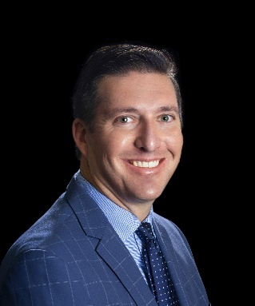
Scott Casanover’s Background
PRACTICE AND EXPERIENCE
  Scott Casanover oversees the global legal and government affairs functions for West Coast University and American Career College. In this capacity he provides advanced litigation strategy, regulatory interpretation and guidance, and key corporate legal support to the schools he serves
  Prior to joining WCU and ACC, Casanover was the General Counsel and Chief Administrative Officer for Vatterott College in St. Louis, Missouri. In addition to these positions, Casanover was an Associate in the St. Louis office of Husch Blackwell
  Casanover earned his Bachelor’s Degree in Political Science from Baylor University, and a Juris Doctor from Washington University
Notes:
Brandon

Slide 5
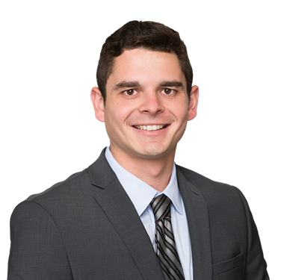
Daniel Kusmin’s Background
PRACTICE AND EXPERIENCE
  SVP & Education Practice Group Co-Lead
  Works almost exclusively with for-profit higher education institutions. Where he specializes in helping them manage their unique risk profile
  Graduated with a Bachelor of Science Degree in Finance from the University of Kansas and holds his Associate in Risk Management (ARM) designation
  Daniel was named to the 2018 class of Ingram’s 20 in their Twenties
913.832.8878
dkusmin@cobbsallen.com
Notes:
Brandon

Slide 6
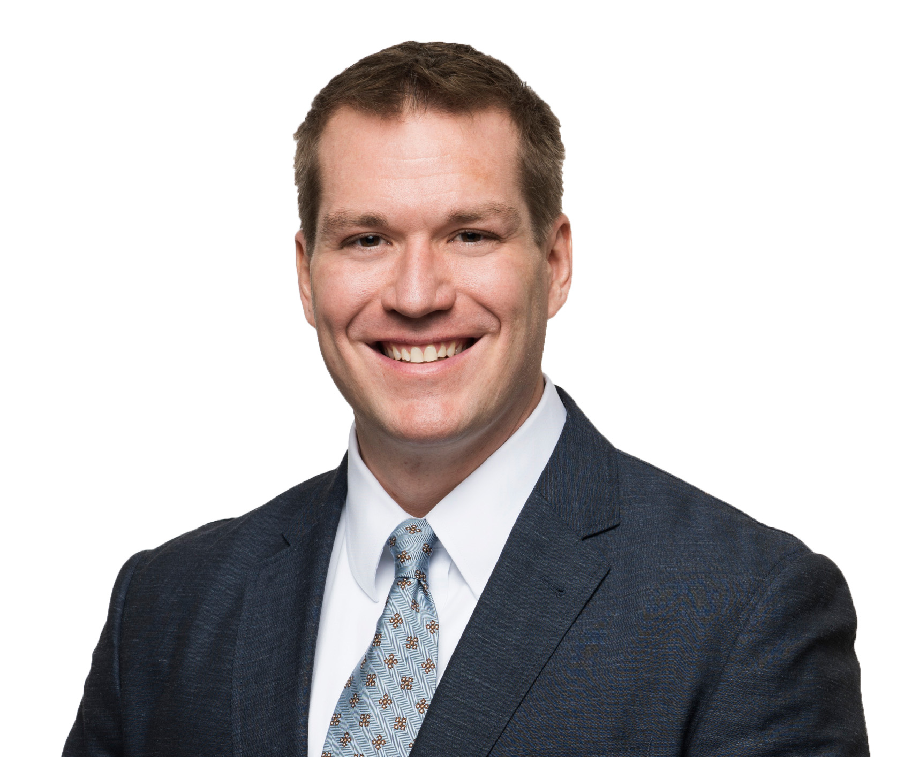
Tres Cleveland’s Background
PRACTICE AND EXPERIENCE
  Tres serves as Chair of the Education Practice at Maynard
  Represents educational institutions, third-party servicers, and financial investors in dozens of reported cases in courts throughout the country
  Advises institutions, investors and financers in higher education mergers and acquisitions, and in other complex corporate restructuring matters, including bankruptcies and receiverships
205.254.1183
tcleveland@maynardcooper.com
Notes:
Brandon

Slide 7
HIGHER EDUCATION PRACTICE
Maynard’s Higher Education Practice Group is deeply experienced and entrenched in all facets of regulatory issues that are important to institutions, investors, third-party servicers and accrediting agencies
Title IV
Accreditation
Cybersecurity
False Claims Act
Transactions
Government Relations
Government Investigations
Title IX
State Licensure
Notes:
Brandon

Slide 8
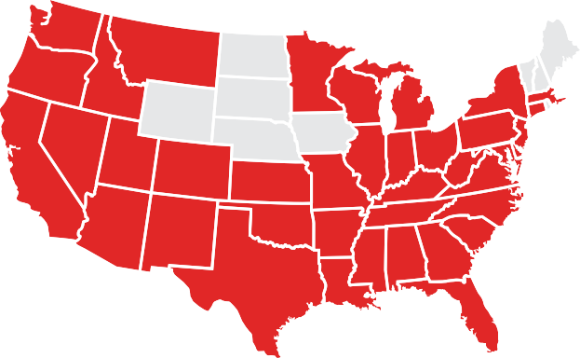



HIGHER EDUCATION ACTIVITY
ABOUT THE EDUCATION PRACTICE GROUP
Insurance programs specifically tailored for education
Marketplace expertise allows for placement of difficult coverages
$30M+ in student claims paid
100+ schools and several hundred thousand students represented annually
Institutions represented in 39 of 50 states
INNOVATIVE SOLUTIONS FOR EDUCATION & BEYOND
Insurance Supported Letter
of Credit
HEERF Insurance Contractual Risk Program Transfer
Parametric Derivatives
Borrowers Defense to Repayment Coverage
Cybeta Cyber Assessment
Notes:
Brandon

Slide 9

Federal trade commission
The Federal Trade Commission (FTC) is an independent federal agency whose principal mission is the enforcement of civil U.S. antitrust law and the promotion of consumer protection.
The FTC is governed by a Commission.
The Commission is composed of five Commissioners, who each serve seven-year terms
Notes:
Brandon

Slide 10
Federal trade commission
The FTC enforces section 5(a) of the FTC Act, 15 U.S.C. § 45(a), which prohibits unfair or deceptive acts or practices in or affecting commerce.
  “Deceptive” practices are defined in the FTC’s Policy Statement on Deception as involving a material representation, omission or practice that is likely to mislead a consumer acting reasonably in the circumstances.
“The FTC has broad authority to target unfair and deceptive practices in the for-profit school sector, but its approach has varied over the years.” (former FTC Commissioner Rohit Chopra)
Notes:
Brandon

Slide 11
SECTION 5 AUTHORITY
Under section 5 of the Federal Trade Commission Act, the FTC can seek civil penalties if it proves that:
  The company knew the conduct was unfair or deceptive in violation of the FTC Act; and
  The FTC had already issued a written decision that such conduct is unfair or deceptive.
Notes:
Brandon

Slide 12
Prior approach
Few enforcement actions were taken by the FTC against for-profit colleges.
The FTC did not utilize section 5 authority.
During the Trump administration, the FTC ended its coordination with the U.S. Department of Education.
Notes:
Brandon

Slide 13

ENFORCEMENT ACTIONS
  University of Phoenix
  Settled for a $191 million to resolve charges that they used deceptive advertisements that falsely touted their relationships and job opportunities with companies such as AT&T, Microsoft, and The American Red Cross
  Career Education Corporation
  Ordered to pay $30 million to settle charges that the operator used sales leads from lead generators that falsely told consumers they were affiliated with the U.S. military, and that used other unlawful tactics to generate leads
Notes:
Scott

Slide 14

Notes:
Scott

Slide 15
Why the change in approach?
REASONS CITED BY THE FTC
  AMG v. FTC, 141 S. Ct. 1341, 1344 (2021)
  Perception
    “For too long, unscrupulous for-profit schools have preyed on students with impunity, facing no penalties when they defraud their students and drive them into debt,” said FTC Chair Lina M. Khan
  Political
  Student debt and loan default
  Increase in complaints to the FTC
    Complaints to the FTC around education-related issues surged roughly 70 percent between 2018 and 2020
Notes:
Scott

Slide 16
New approach
In October 2021, the FTC announced that it is making a number of critical changes to its approach to address “the rampant abuse of students, veterans, their families, and taxpayers” by for-profit colleges
CHANGES INCLUDE:
  The FTC is resurrecting its Penalty Offense Authority, found in section 5 of the FTC Act.
  “FTC will be enhancing its enforcement cooperation with other oversight agencies.”
    “FTC investigations can assist the Department of Education in taking additional administrative actions against those that violate the law”
Notes:
Scott

Slide 17

Notice of penalty offenses
The FTC sent notices to 70 for-profit institutions on October 6, 2021:
In order to exercise the Penalty Offense Authority, the FTC also must show that the alleged violator (School B) had “actual knowledge that such act or practice is unfair or deceptive and is unlawful” under the law. Thus, in order to strengthen its position that the 70 institutions on the list are aware of and have “actual knowledge” of the kind of conduct prohibited under the law, the FTC sent the 70 institutions the notice, which details certain acts or practices that have previously been found in litigated administrative decisions to be deceptive or unfair. In other words, there was a very specific purpose to the notice: to strengthen the ability of the FTC to use its Penalty Offense Authority against the institutions on the list.
Link to announcement
Notes:
Scott

Slide 18

Notice of penalty offenses
Future findings of violations by any of the noticed institutions can lead to civil penalties up to $43,792 per violation.
No immediate action or investigation was announced, but this portends an intention by the FTC to take future action against some or all of the noticed institutions
Notes:
Scott

Slide 19
FTC Advanced notice of proposed Rulemaking
On March 11, 2022, the FTC announced that it is considering proposing a rule to address deceptive or unfair marketing using earnings claims. https://www.ftc.gov/legal-library/browse/federal-register-notices/16-cfr-part-462-trade-regulation-rule-use-earnings-claims.
Such a rule would allow the FTC to (1) move quickly to stop illegal conduct; (2) clarify for businesses what constitutes a deceptive earnings claim and what it means to have substantiation for an earnings claim; and (3) enable the FTC to seek monetary relief for consumers harmed by deceptive earnings claims, as well as civil penalties against those who make the deceptive claim.
The FTC cites an enforcement action taken against a for-profit school for “false[] claim[s] that its graduates averaged 15 percent higher incomes one year after graduation than graduates of other schools”
Notes:
Tres

Slide 20
FTC Advanced notice of proposed Rulemaking
The FTC requested comments from the public about a wide variety of issues, including:
    Whether earnings claims are prevalent among all or only some industries;
    How a rule addressing earnings claims should be drafted, the benefits to consumers from such a rule and the costs to businesses; and
    Whether the potential rule should address disclaimers, lifestyle claims, or liability for agents’ claims.
If the FTC decides to proceed after reviewing public comments, its next step would be to issue an NPRM.
Notes:
Tres

Slide 21

Prohibited practices:
    To misrepresent the number or percentage of people attending any course or completing any program or degree who have obtained employment, or the field or nature of that employment;
    To misrepresent how much grads will or may earn;
    To misrepresent the qualifications necessary to get jobs in the fields for which an institution offers training, including whether experience or additional education is required or advantageous; and
    To misrepresent the institution’s capabilities for helping students find employment or the assistance actually given to grads, including the existence of job placement services
Notes:
tres

Slide 22

Prohibited Practice:
Misrepresenting Demand for Graduates
Advertisements, sales brochures, representations by a University’s agents:
“Opportunities for trained decorators are increasing each year. It used to be that only the wealthy employed decorators. That's no longer true. Large numbers of average homemakers now rely on the services of decorators. . . .”
“Decorators today are busy in many areas besides homes. Their talents are employed in decorating hotel rooms, business offices, building lobbies, hospitals and many other interesting places. Some decorators operate their own businesses; others work in major stores, showrooms and design studios.”
“I have now opened a studio . . . and I am already getting demands for interior decorating services”
Notes:
Tres

Slide 23
Prohibited Practice:
Misrepresenting Demand for Graduates
Claims:
  “The impression was created in the first few pages of the brochure that there was a demand for interior decorators”
  “The combination in LaSalle's advertisements of the success stories featured in the testimonials, the claims of complete, up-to-date training, and the representations to the effect that you, the reader, would be able to turn your love for decorating into a dream career conveyed the impression that a graduate of LaSalle's interior decorating course would be qualified to obtain employment in the field of interior decorating without further training”
Expert Testimony Did Not Support Claims:
  “Expert testimony showed that while LaSalle offered training in the basics of interior decorating, it did not adequately prepare the ordinary and typical individual to be an advanced level interior decorator”
Notes:
Tres

Slide 24
Prohibited Practice: misrepresenting Graduate Income
Brochure included testimonials:
  “My interior decorating course enabled me to get a terrific new position in a furniture showroom and most importantly, my salary has doubled.”
“My salary has doubled.”
“My salary has more than doubled since I started my new career.”
Unsubstantiated:
  Since the ordinary and typical interior decorating graduate would be unable to open his/her own decorating service or obtain employment beyond the basic level, representations regarding income growth were deceptive
Notes:
Tres

Slide 25
Prohibited Practice:
Misrepresenting Qualifications in the Field
Claims in Advertisements:
  “For a prestige career why not get into computer programming.”
  “You'll find learning Basic Computer Programming with LaSalle an ideal way to prepare for the computer age.”
  A LaSalle sales representative stated that “LaSalle's placement record was excellent and if [the student] did all the home work and like that and got good grades on it, [the student] should have no problem getting into the field.”
Deceptive Statement:
  “The ordinary and typical graduate of LaSalle's computer programming course would not qualify as a computer programming trainee. Respondents' representation that the graduates of its computer programming course would qualify as computer programming trainees was accordingly deceptive”
Notes:
Tres

Slide 26








Actions to take Now
Gather and evaluate any materials in which claims are made about demand for, or outcomes of, graduates.
Focus is on publicly available information.
Don’t forget lead aggregators and marketing agencies!
 | Internet ads/search engine optimization |  | School catalog
 | Call scripts |  | Vendor contracts
 | School website |  | Partnership agreements
 | Television/radio ads |  | Social media
Notes:
Brandon

Slide 27

Actions to Take Now (cont.)
Evaluate training materials provided to representatives to ensure that the representatives are trained not to make claims that the FTC might consider deceptive.
Consider emailing the representatives a short memo explaining that the institution wants to remind the representatives that it is the institution’s practice to provide true and accurate information to prospective students and graduates, and that representatives should ensure that they continue to provide truthful information and refrain from making claims that the FTC would consider deceptive
Notes:
Brandon

Slide 28
Actions to Take Now (cont.)
Carefully evaluate whether the claims made in those materials are accurate and, in particular, whether they can be substantiated with facts or data in the institution’s possession.
If so, ensure that the information is retained in a secure manner so that the institution can quickly retrieve and produce it if needed.
If any claims cannot be substantiated, the institution should consider revising advertising and related materials.
Notes:
Brandon

Slide 29
Actions to Take Now (cont.)
Evaluate the overall impression conveyed by advertisements from the standpoint of a reasonable consumer.
Evaluate individual statements from the standpoint of a reasonable consumer.
Ensure clear and conspicuous disclaimers are offered; consider placement, prominence, and clarity of the disclaimer.
Notes:
Brandon

Slide 30
TRANSFERRING FTC RISK TO THE INSURANCE MARKETPLACE
Insurance Policies to Consider:
  Privately Held Companies:
  Combined Directors & Officers/Educator’s Legal Liability Policy
  Publicly Traded Companies:
  Professional (Educators’ Legal Liability)
Notes:
Daniel

Slide 31
DIRECTORS & OFFICERS (D&0) CONSIDERATIONS
Professional Services Carve back
  Ideally the policy is written as a combined D&O/E&O policy
Antitrust Exclusion & Coverage
False Advertising & Consumer Protection Exclusions
Manuscript Language
Choice of Counsel Provisions
Notes:
Daniel

Slide 32
INSURANCE MARKETPLACE DYNAMICS
Limited marketplace for proprietary education
Currently ~4-5 markets that are willing to provide the correct terms on the primary policy
More carriers are willing to consider risk on an excess basis
Notes:
Daniel

Slide 33
LIMITS, RETENTIONS, PREMIUM & SIDE-A
There is market capacity for high limit towers
No crystal ball for correct level of limit
  Ask your broker for benchmarking
  Consult with counsel
Retentions for this type of coverage can run high - $100k+ typically. Not uncommon to see $500k+
Premiums are a function of size, financial stability, marketing practices, overall market conditions – underwriting process can be involved
Side-A DIC policies should be considered
Notes:
Daniel

Slide 34
GLBA- Safeguards Rule
Gramm-Leach-Bliley Act, Safeguards Rule (GLBA)
  GLBA requires financial institutions to protect customer financial information. (e.g. FAFSA information)
    Colleges are considered “financial institutions”
  GLBA is enforced by the Federal Trade Commission and is required under Program Participation Agreements.
    Non-compliance can result in a find of a lack of Administrative Capability, placement on Heightened Cash Monitoring, and a loss of access to FSA systems.
Notes:
Daniel

Slide 35
Revised Safeguards Rule
Requires financial institutions to design and implement safeguards to control risks, including by:
  Access controls
  Encryption
  Change management
  Multi-factor authentication
  Disposal of customer information
  Monitoring
Notes:
Brandon

Slide 36
Revised Safeguards Rule
Financial institutions:
  Must prepare a written risk assessment.
  Must develop and implement an incident response plan.
  Must “periodically assess” their service providers on an ongoing basis.
Notes:
Brandon

Slide 37
Revised Safeguards Rule
Financial institutions:
  Must designate a “Qualified Individual” responsible for overseeing and implementing a financial institution’s information security program and enforcing its information security program.
  The qualified individual must submit an information security report in writing and at least annually to the institution’s board of directors or equivalent governing body.
Notes:
Brandon

Slide 38
Revised Safeguards Rule
  Training requirements:
    Provide all personnel with security awareness training; and
    Verify that key information security personnel take steps to maintain current knowledge of changing information security threats and countermeasures.
Notes:
Brandon

Slide 39
Revised Safeguards Rule
Small business exemption: Financial institutions that collect information about fewer than 5,000 consumers from certain requirements.
This Final Rule became effective on January 10, 2022.
  However, certain new requirements will become effective on December 9, 2022.
Notes:
Brandon

Slide 40
CFPB Cybersecurity
Consumer Financial Protection Circular 2022-04 (August 11, 2022)
  “[F]inancial companies are at risk of violating the Consumer Financial Protection Act if they fail to have adequate measures to protect against data security incidents.”
  “Actual injury is not required to satisfy this prong in every case.”
  “Where companies forgo reasonable cost-efficient measures to protect consumer data, [] the CFPB expects the risk of substantial injury to consumers will outweigh any purported countervailing benefits to consumers or competition.”
  The circular notes some examples where the failure to implement the following data security measures might increase the risk that a firm’s conduct triggers liability under the Consumer Financial Protection Act, including:
    Multi-factor authentication
    Adequate password management
    Timely software updates
Notes:
Brandon

Slide 41
ADDITIONAL Resources
FTC Vocational School Guides
FTC.com Disclosures
Consumer Financial Protection Circular 2022-04

Slide 42
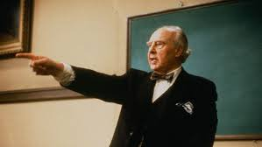
Questions?

Slide 43
Thank you!

